Slide 1
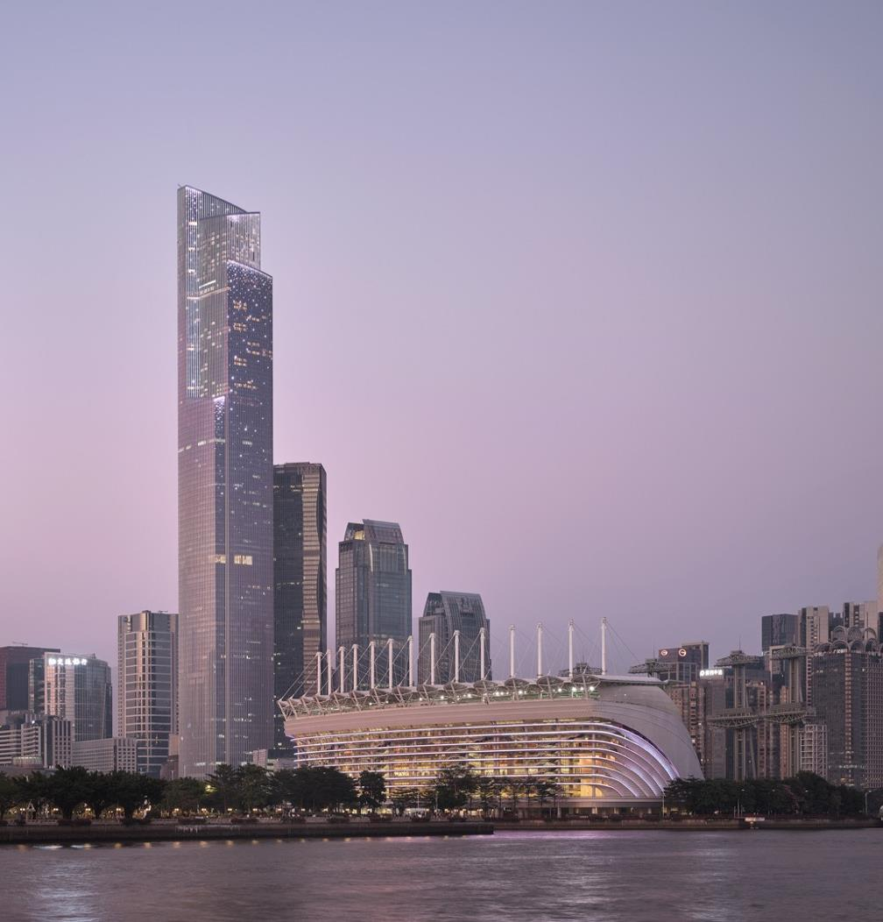


Slide 3
Notes:
OPTION #1

Slide 6
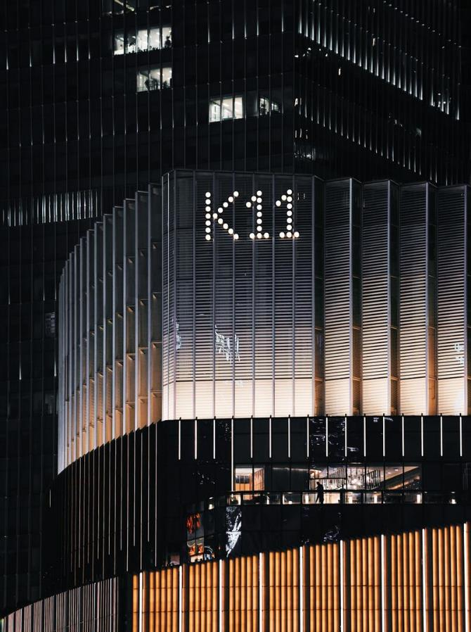
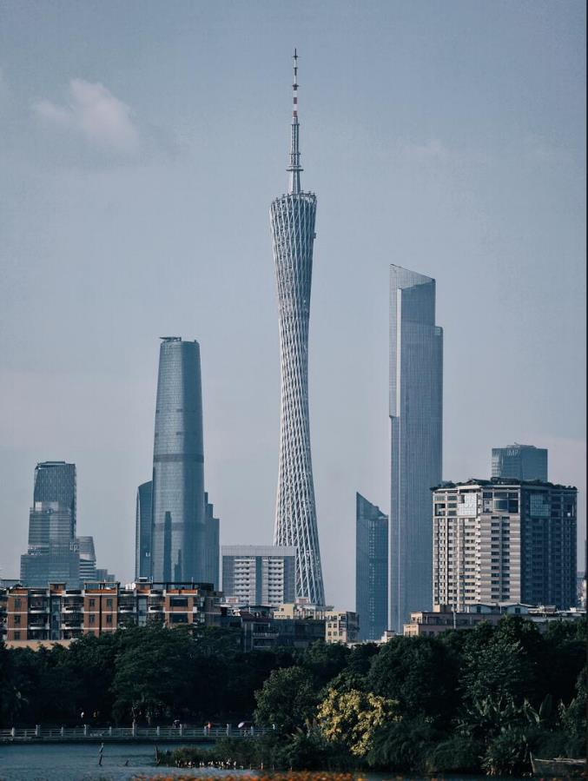
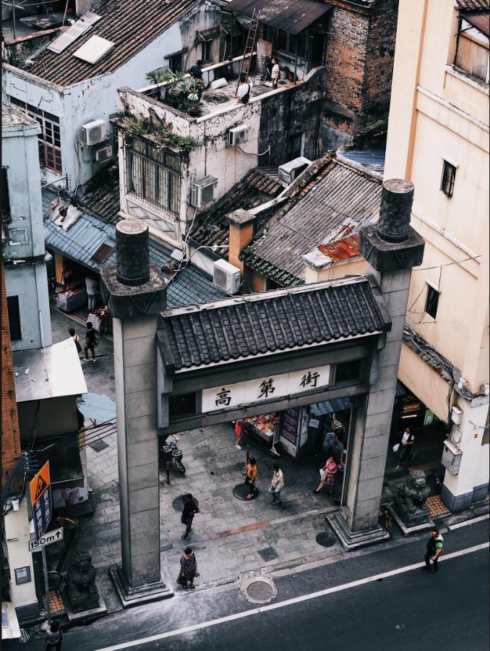
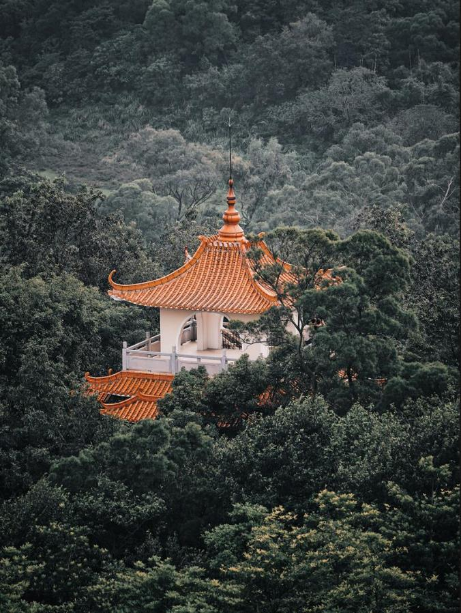
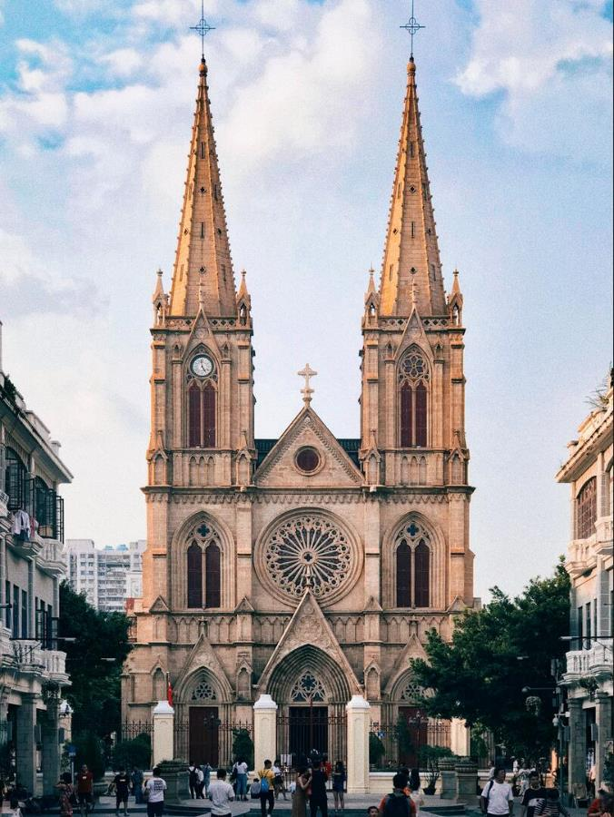
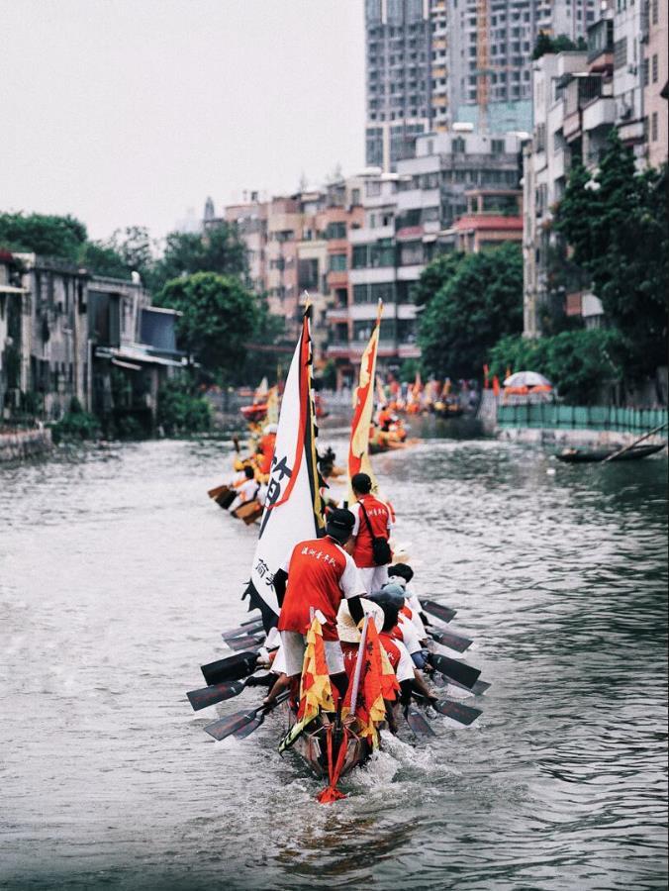
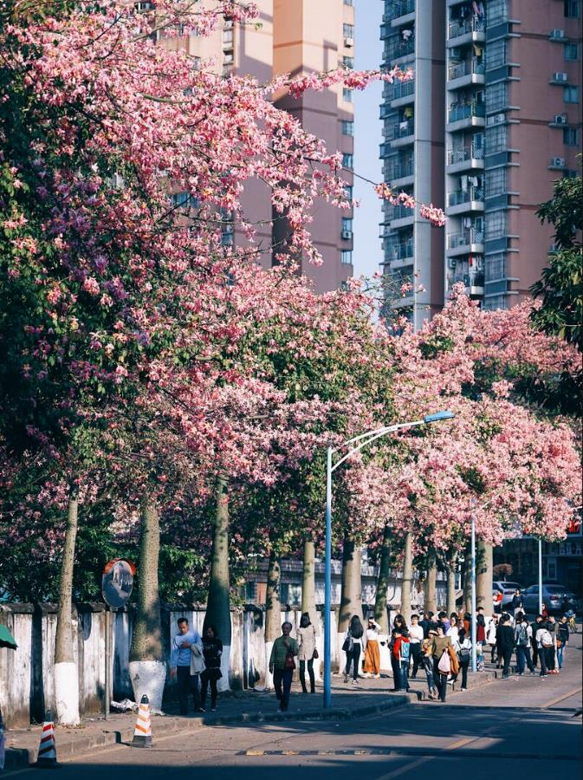
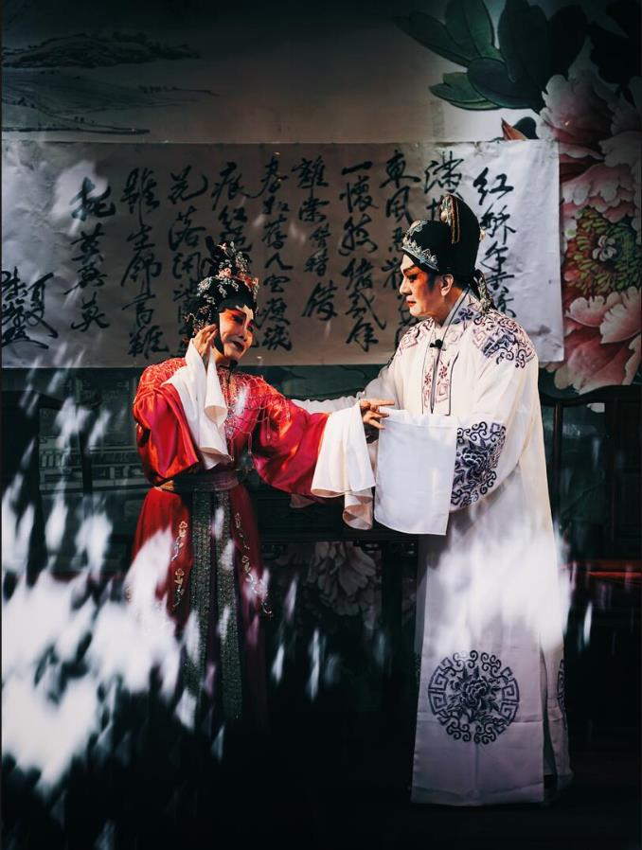

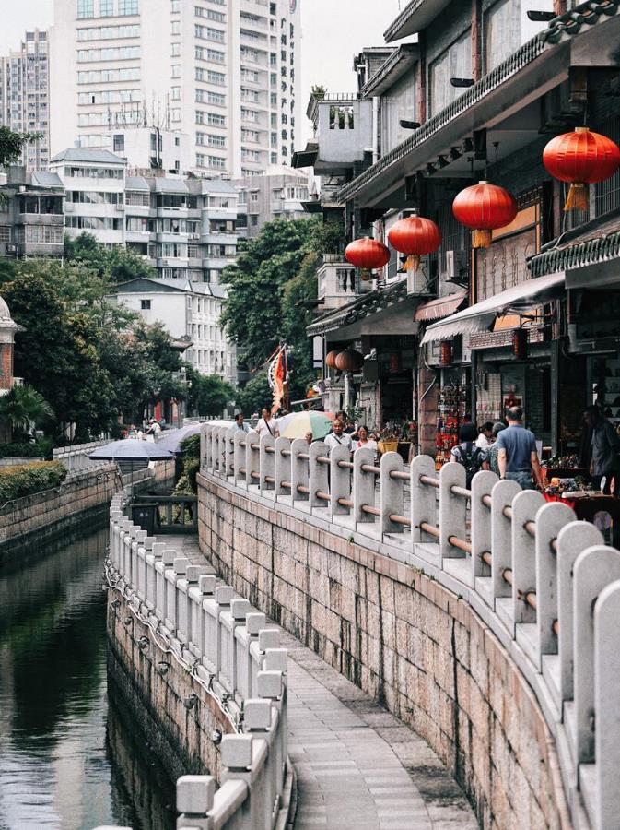
K11 MALL
1min walk / 100m
Canton Tower
9mins by car / 3.7km
Gaodi Lane
28mins by car / 9.3km
Baiyun Mountain
24mins by car / 13.8km
Shishi Sacred Heart Cathedral
36mins by car / 11km
Dragon Boat Festival
7mins by car / 1.6km
Dongshankou
18mins by car / 4.7km
Guangzhou Cantonese Opera Art Center
20mins by car / 5.8km
Yuexiu Park
28mins by car / 9.9km
Liwan
47mins by car / 14km

Slide 7
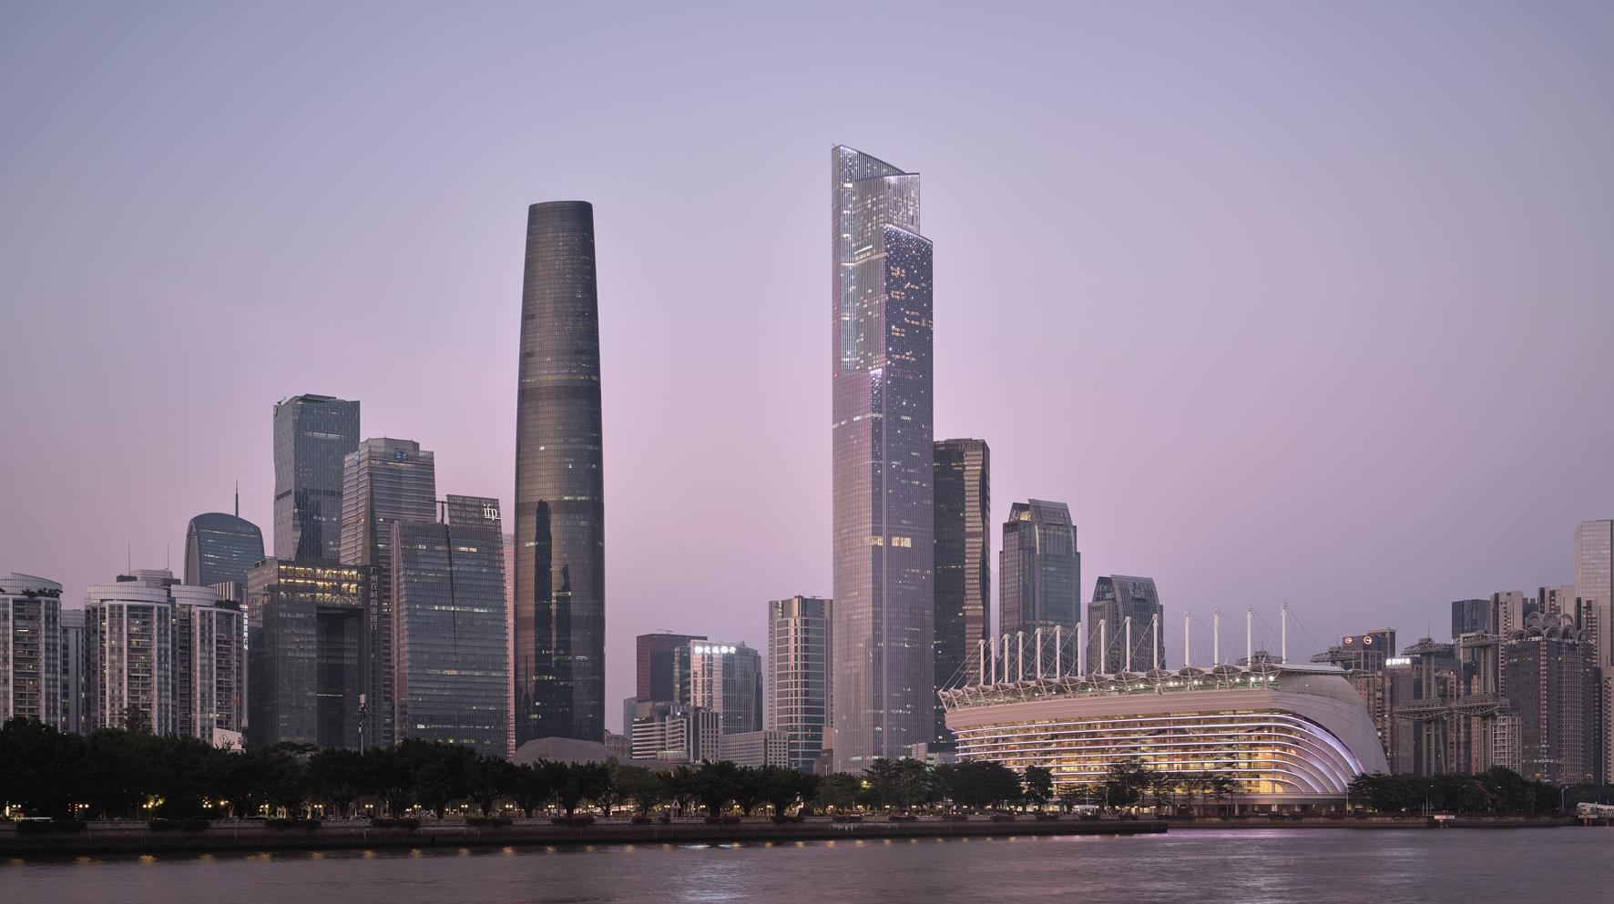

Slide 8

ROSEWOOD GUANGZHOU

Slide 9
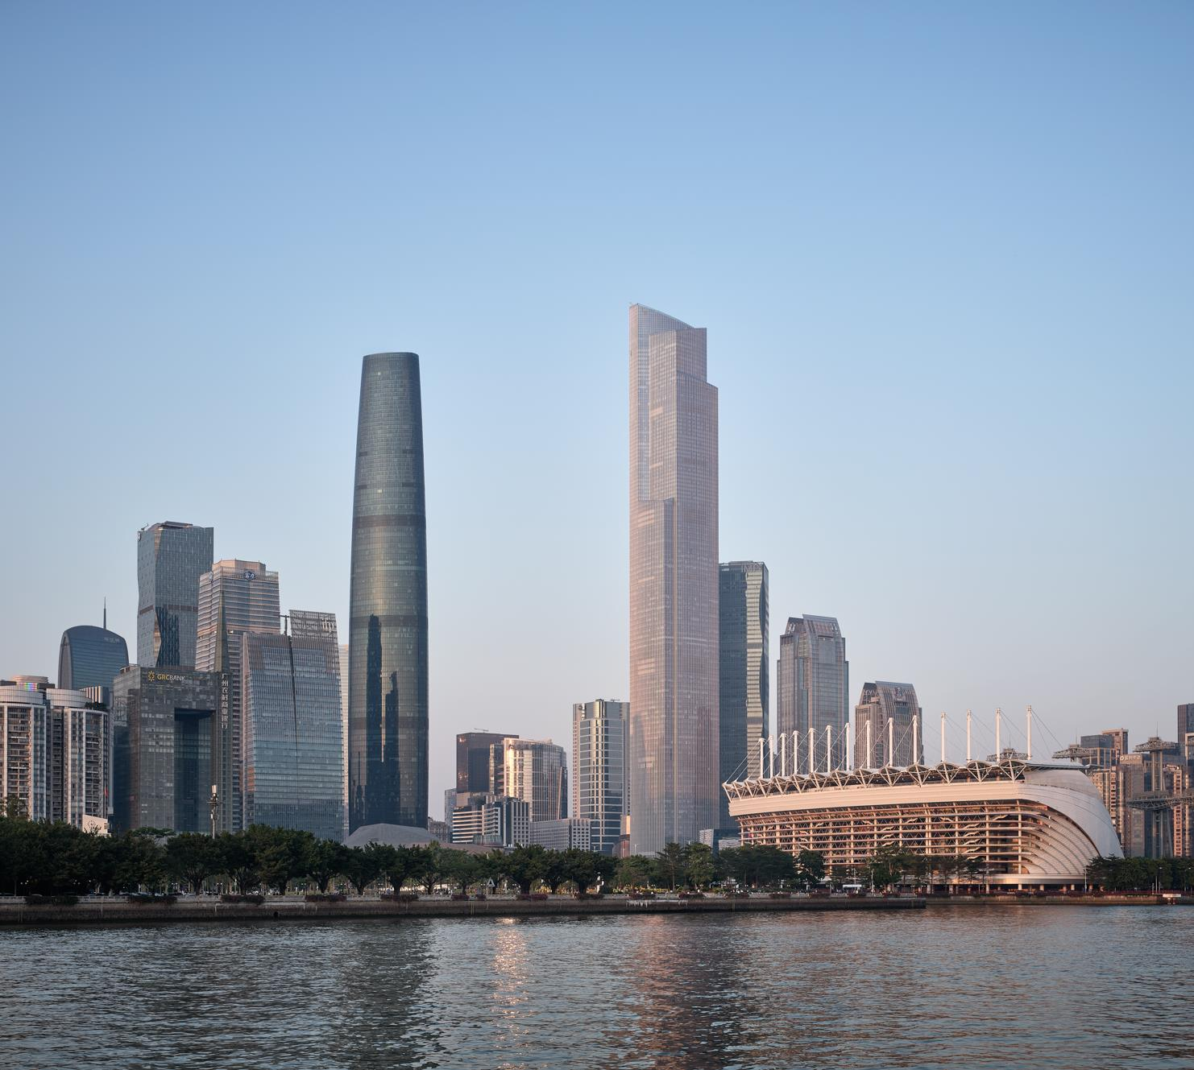
A SENSE OF PLACE
Rising 108 floors above the cosmopolitan streets of the Tianhe District, Rosewood Guangzhou’s occupies an ideal location in the heart of the business district.
The property occupies the top 39 floors and podium of the newly opened CTF Finance Centre – Guangzhou’s tallest building at 530 meters – and is within easy walking distance of prominent commercial centers as well as enriching cultural and architectural landmarks.
SAMPLE IMAGE

Slide 10
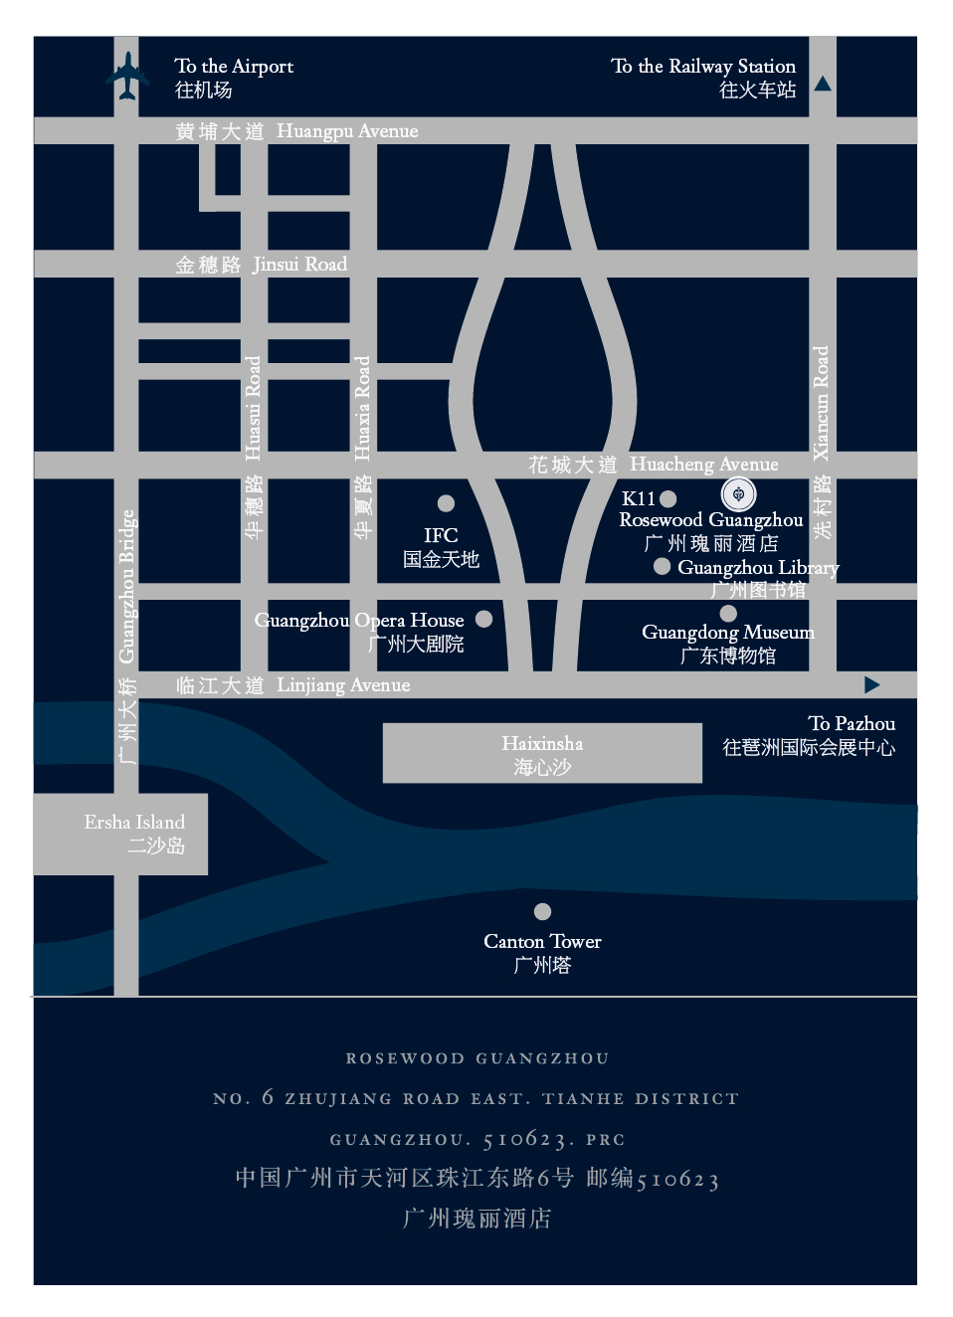
A SENSE OF LOCATION
Guangzhou Baiyun International Airport / 45 mins by car / 39.9 km
Guangzhou East Railway Station / 18 mins by car / 4 km
Guangzhou South Railway Station / 32 mins by car / 21.5 km
Metro – Zhujiang New Town Station / 8 mins by car / 500 m
APM Line - Huacheng Dadao Station / 6 mins by car / 370 m
Straight-Line Distance
K11 MALL / 1 min by walk / 100 m
Guangzhou Library / 3 mins by walk / 200 m
Guangzhou Opera House / 6 mins by walk / 500 m
Guangdong Provincial Museum / 8 mins by walk / 700 m
Haixinsha / 7 mins by car / 1.9 km
Canton Tower / 9 mins by car / 3.7 km
Guangdong Museum of Art / 14 mins by car / 4.8 km
Baiyun Mountain / 34 mins by car / 13.8 km

Slide 11
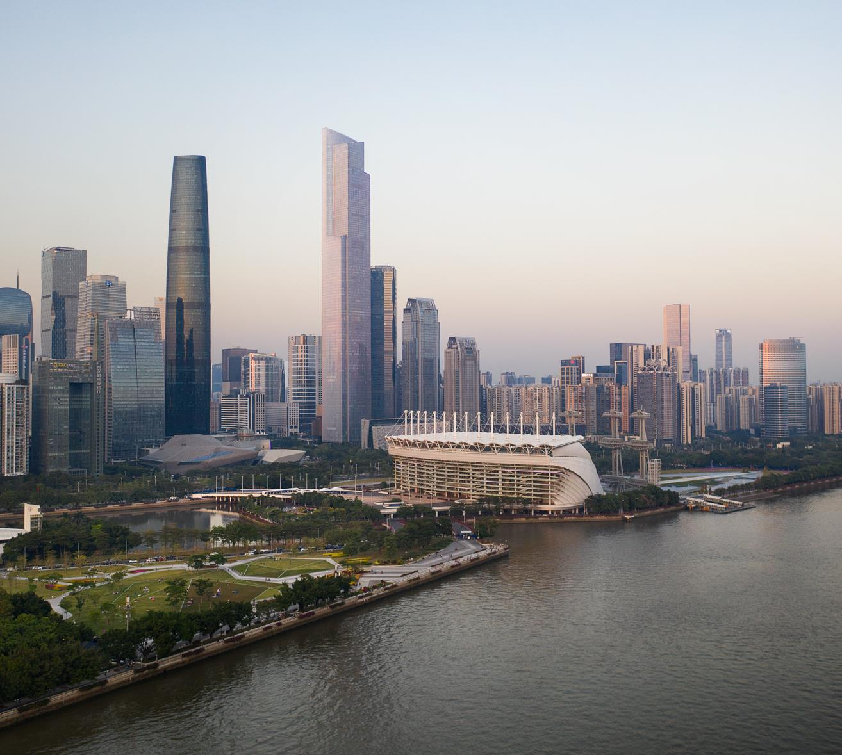
AT A GLANCE
251 HOTEL ROOM
(227 Guest Rooms / 20 Suites /
4 Duplex)
355 RESIDENCES
(76 Studio / 160 One Bedroom /
96 Two Bedroom /
19 Two Bedroom Duplex /
4 Three Bedroom Duplex)
7 Restaurants & Bars
9 Events Venues
2 Floors of Wellness Facilities
SAMPLE IMAGE

Slide 12

ACCOMMODATION

Slide 13
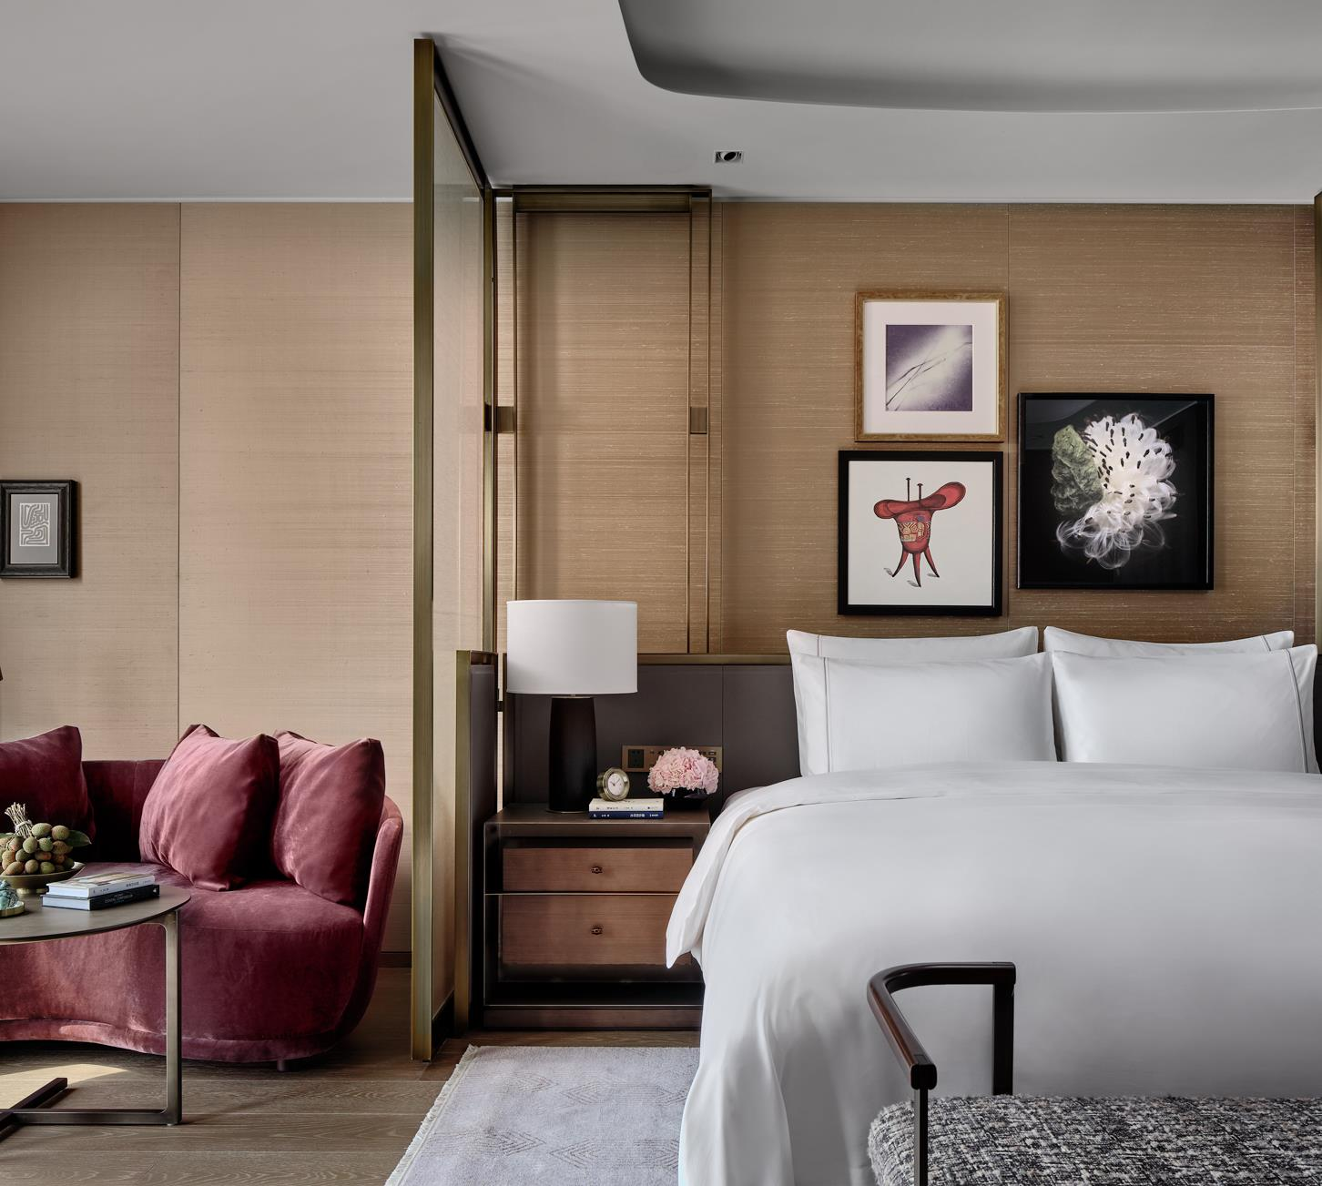
HOTEL & RESIDENCE
Offering the refined style and endless comfort of a private residence, ROSEWOOD GUANGZHOU set a new benchmark for luxury.
MANOR CLUB Perched on the 108th floor, China’s highest club lounge delivers personalized touches and exquisite food and beverage experiences.
RESIDENCE offers Spanning studios, serviced apartments and duplexes paired with spacious layouts, stylish design and stunning city views accentuate the home-from-home experience.
SAMPLE IMAGE
Deluxe Room

Slide 14
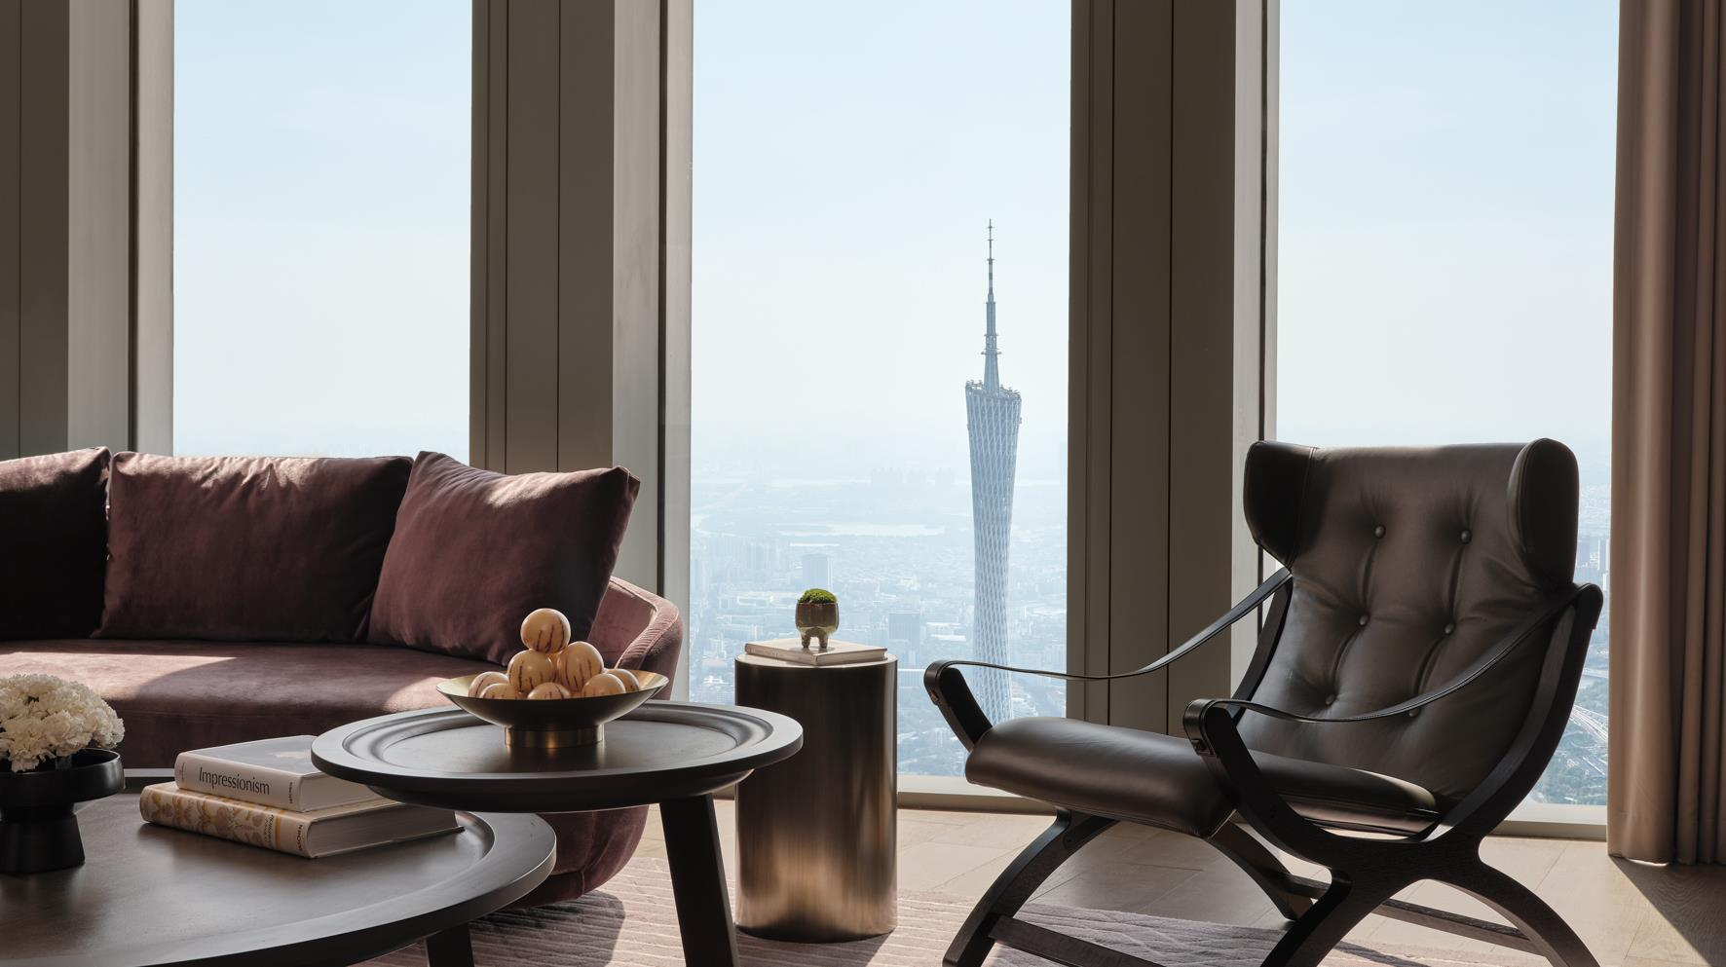
Manor Suite

Slide 15
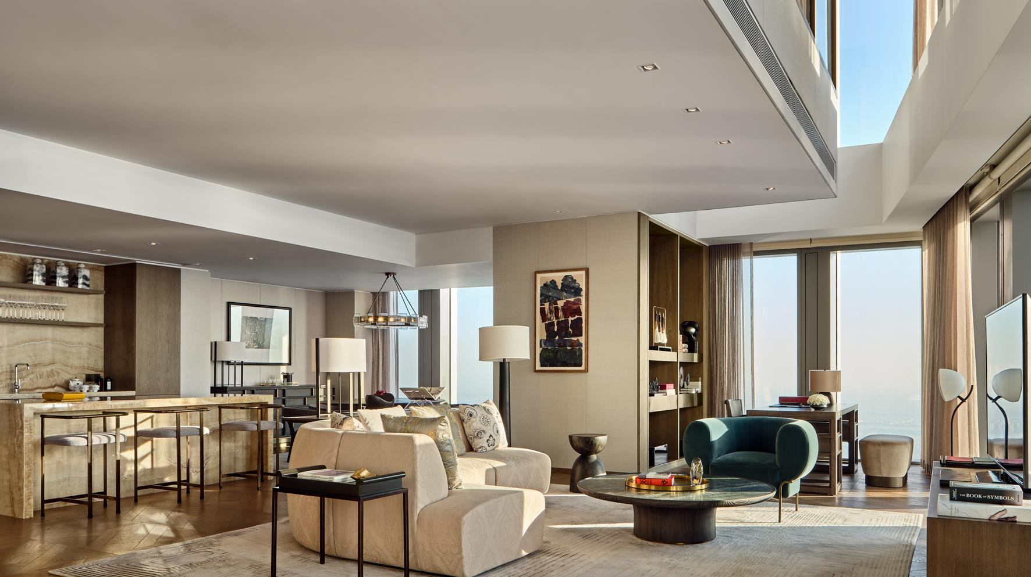
Duplex Xi Guan House

Slide 16
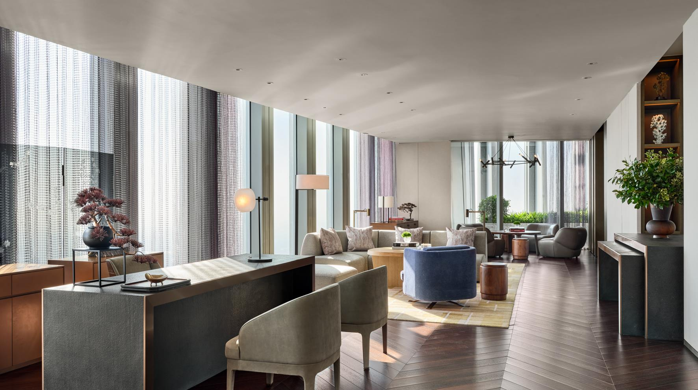
Manor Club on L108

Slide 17
HOTEL GUESTS ROOM CATEGORY
GUEST ROOM | QUANTITY | BED SIZE (METER) | SIZE (SQM)
Deluxe King Room | 71 | 2.03 x 2 | 40 - 50
Deluxe Twin Room | 31 | 2.03 x 1.2 | 40 - 50
Deluxe River King Room | 79 | 2.03 x 2 | 40 - 50
Deluxe River Twin Room | 2 | 2.03 x 1.2 | 52
Premier King Room | 33 | 2.03 x 2 | 64 - 67
Grand Studio | 11 | 2.03 x 2 | 89
Executive Suite | 11 | 2.03 x 2 | 114
Manor Suite | 7 | 2.03 x 2 | 118
Rosewood Suite | 1 | 2.03 x 2 | 157
Rosewood Terrace Suite | 1 | 2.03 x 2 | 157
Xi Guan House | 3 | 2.03 x 2 | 170 – 214
Canton House | 1 | 2.03 x 2 | 275
Total | 251

Slide 18
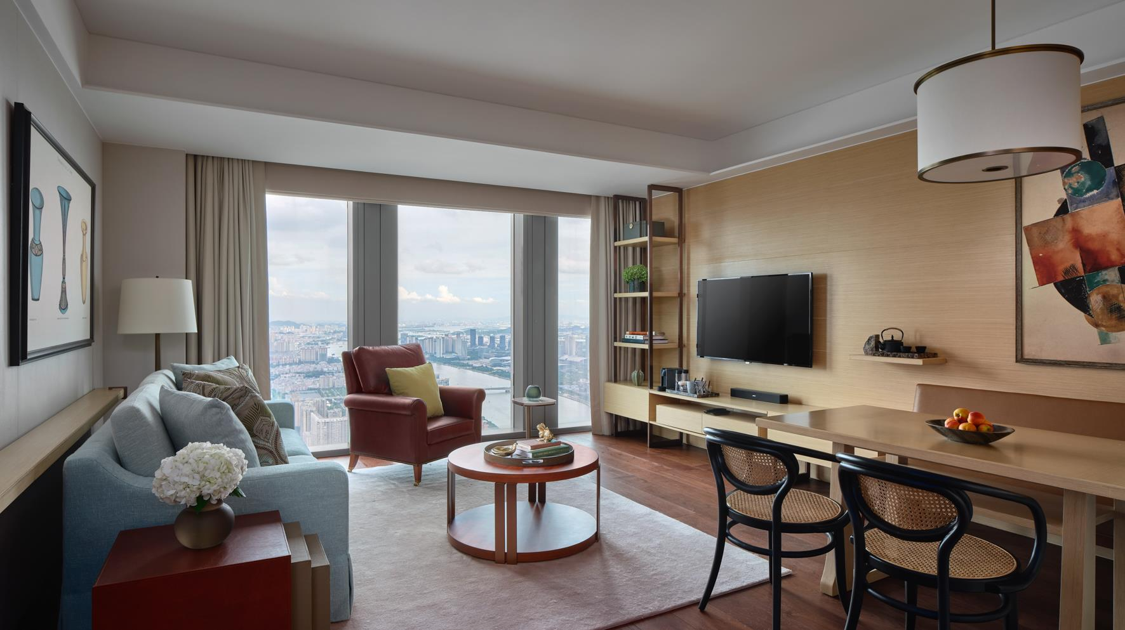
One-Bedroom Residence

Slide 19
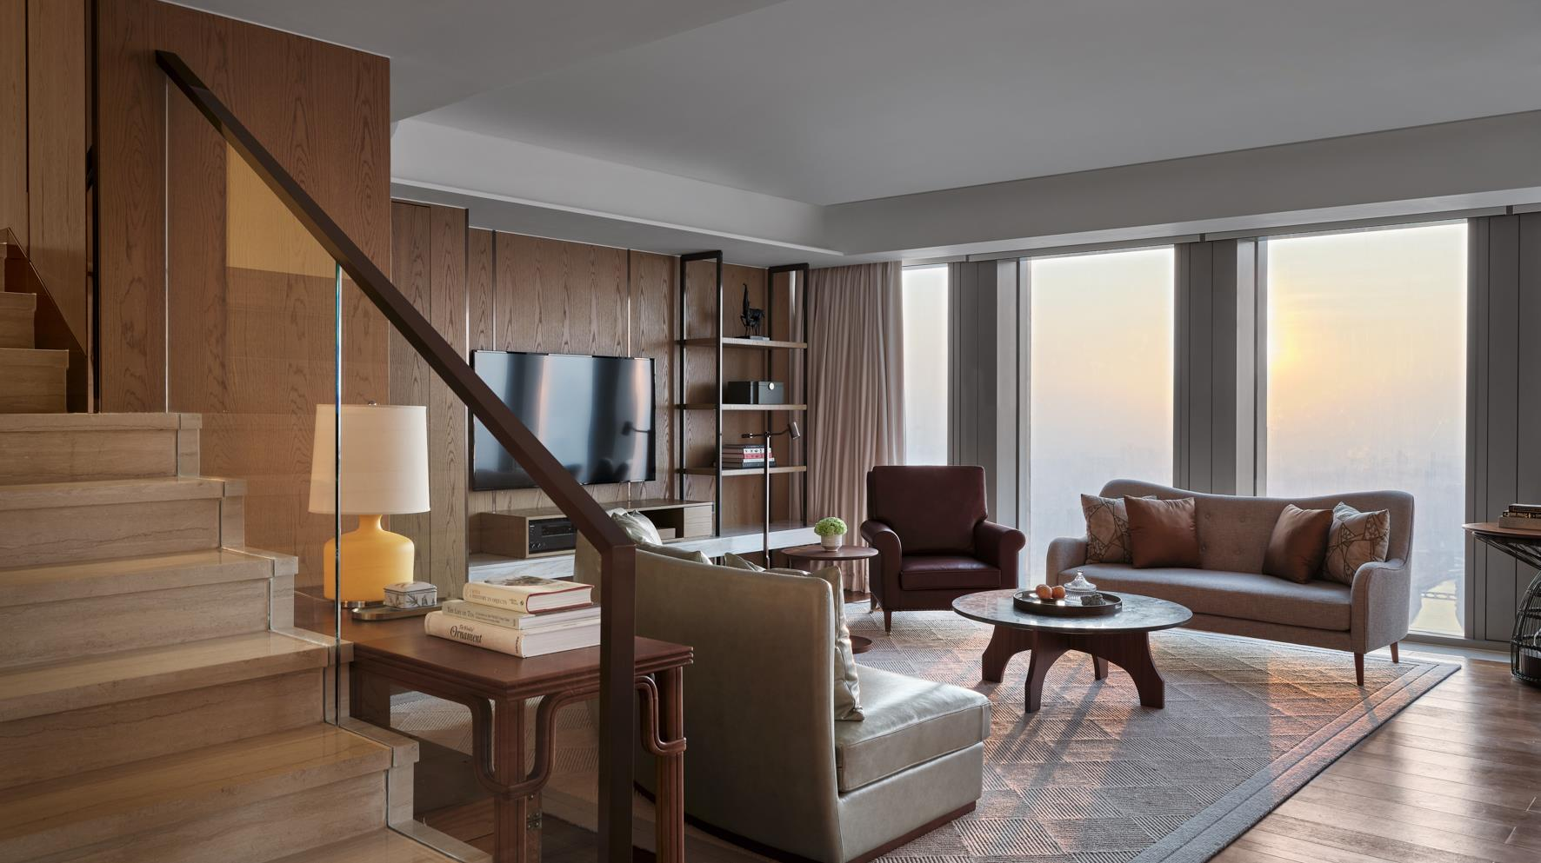
Two-Bedroom Duplex

Slide 20
RESIDENCES ROOM CATEGORY
RESIDENCES | QUANTITY | SIZE (SQM)
Studio | 76 | 44 -54
One Bedroom | 160 | 62- 92
Two Bedroom | 96 | 113 – 149
Two Bedroom Duplex | 19 | 142 – 230
Three Bedroom Duplex | 4 | 264 - 298
Total | 355

Slide 21

RESTAURANTS & BARS

Slide 22
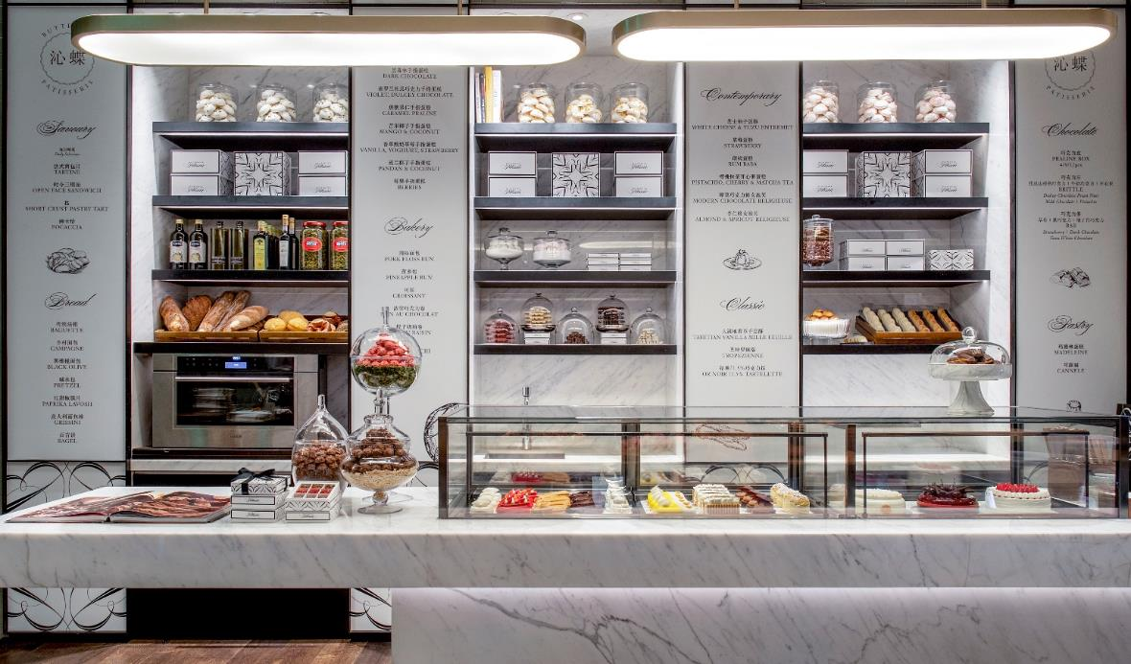
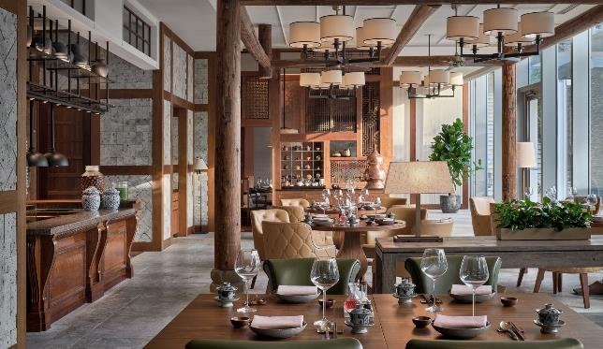
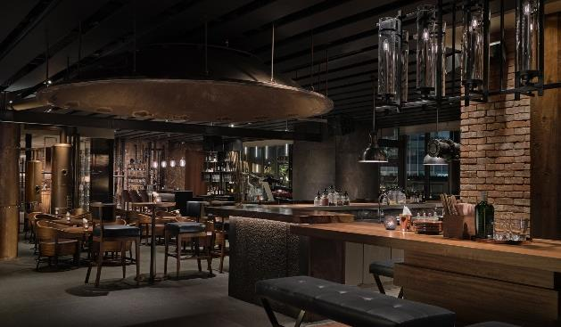
A SENSE OF TASTE
BUTTERFLY PATISSERIE
Level 1
Seating Capacity 34
LINGNAN HOUSE
Level 5
Seating Capacity 218
À La Carte | 3 Stunning Standalone Garden Villas
BRICK LANE
Level 6
Seating Capacity 242
Experience the art of French patisserie at Guangzhou’s most elegant dessert boutique. Inspired by a jewelry atelier, Butterfly Patisserie showcases a delectable range of signature chocolates, seasonal cakes, flaky pastries, and decadent afternoon tea in exquisite surrounds.
Drawing inspiration from the regional classics of Guangdong province.
Fine-dining Cantonese cuisine executed with carefully sourced and sustainable ingredients in an interactive environment.
One Michelin star restaurant by Michelin guide Guangzhou 2020 - 2022.
One Diamond Restaurant 2021 – 2022 and Two Diamond Restaurant 2023 by Black Pearl Restaurant Guide.
A cosmopolitan setting, Brick Lane offers a bar, brewery, wine bar, hibachi grill and large outdoor terrace, making it a sought-after venue for social affairs. A carefully curated drinks list offers an array of tipples with live entertainment.

Slide 23
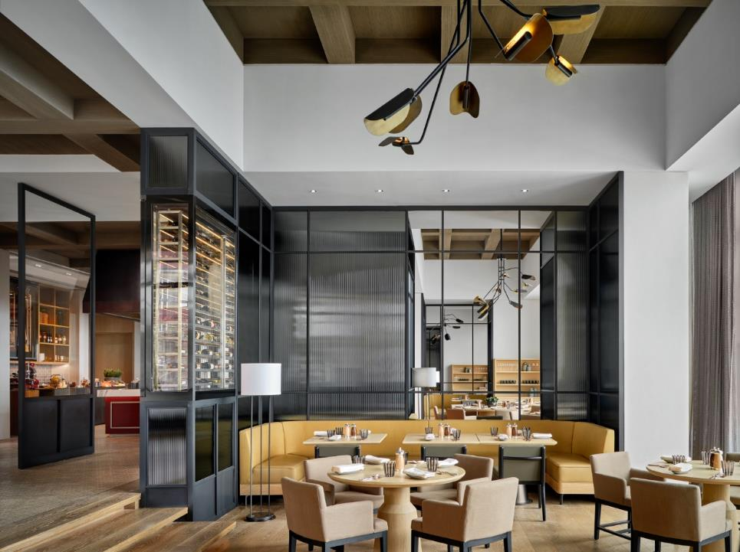
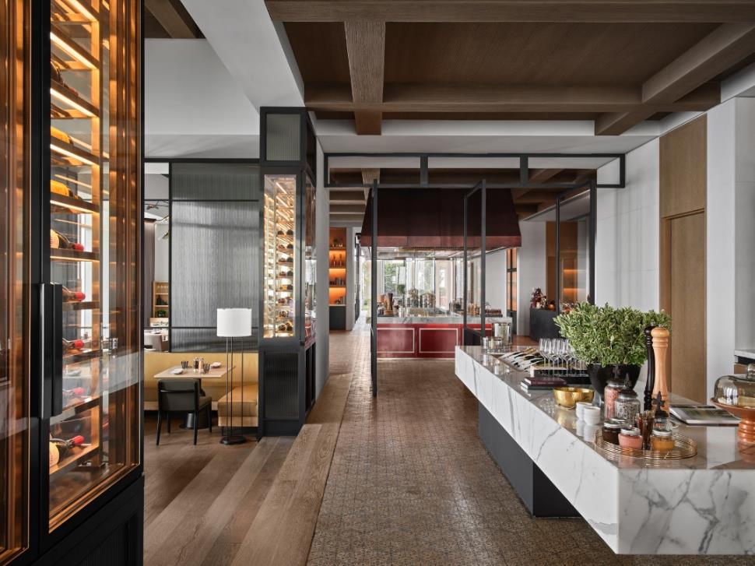
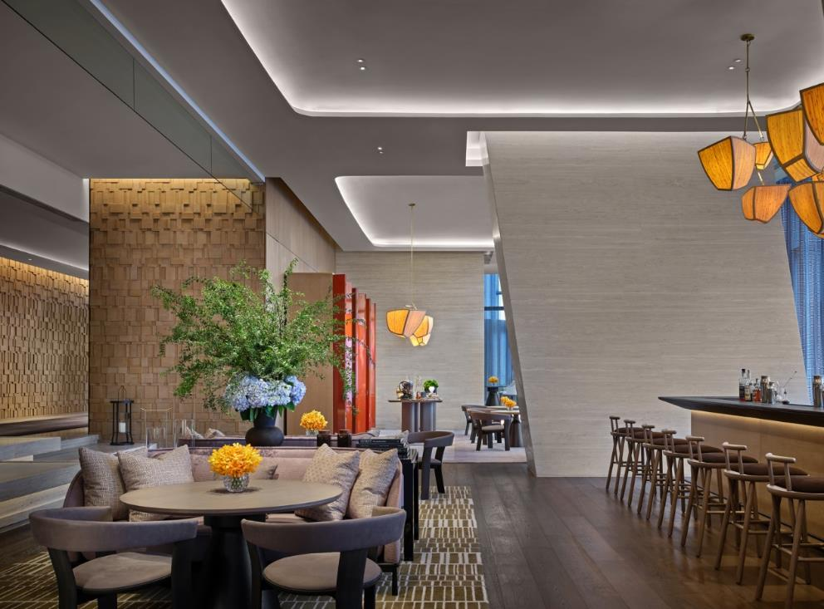
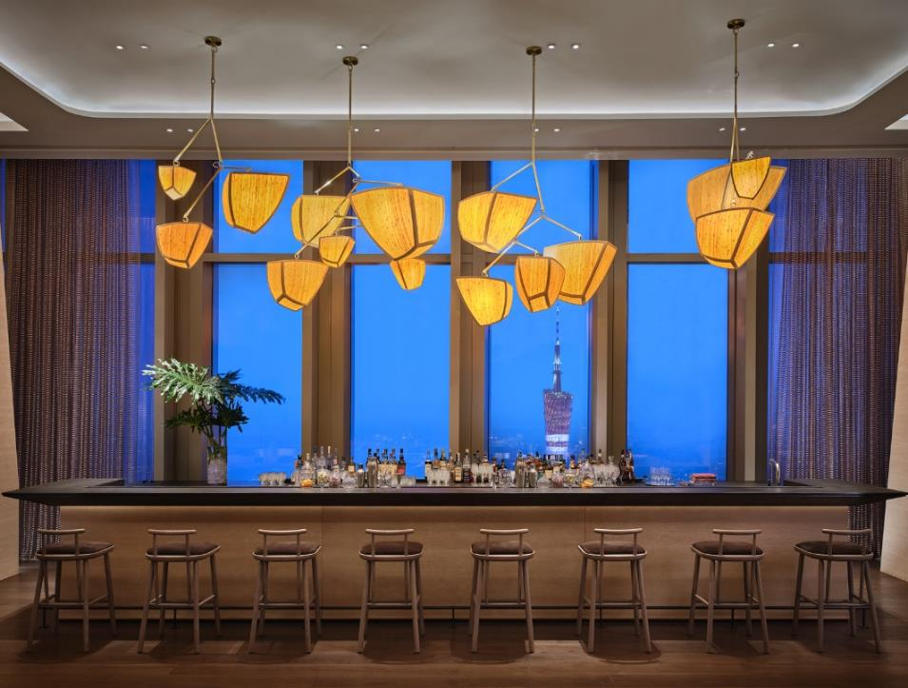
A SENSE OF TASTE
PATINA EUROPEAN BRASSERIE & TERRACE
Level 95
Seating Capacity 129
THE BUTTERFLY ROOM
Level 95
Seating Capacity 73
All-day dining with European influences served with unparalleled city views.
Focus on fresh, high-quality seafood that’s been sourced sustainably from trusted partners.
Glamorous afternoon tea, refined sweet and savoury bites and carefully curated tipples.

Slide 24
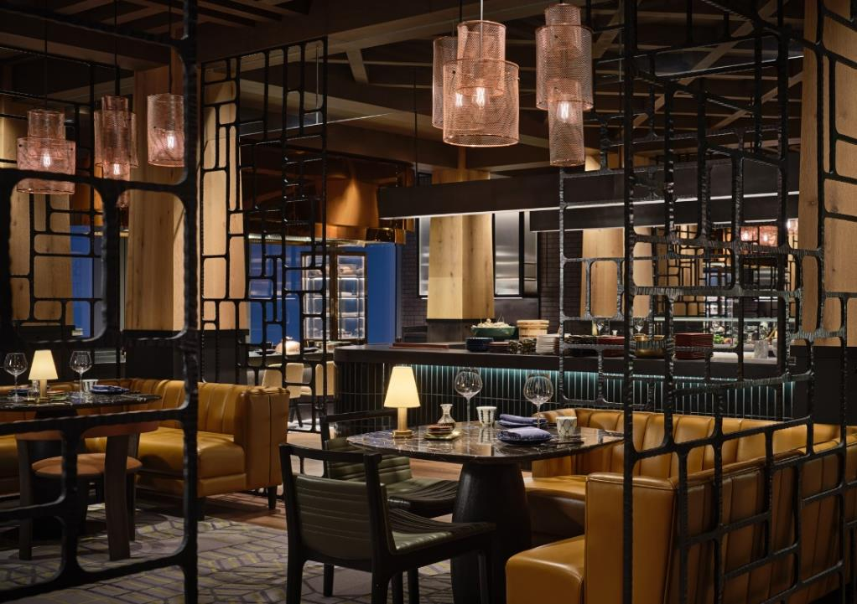
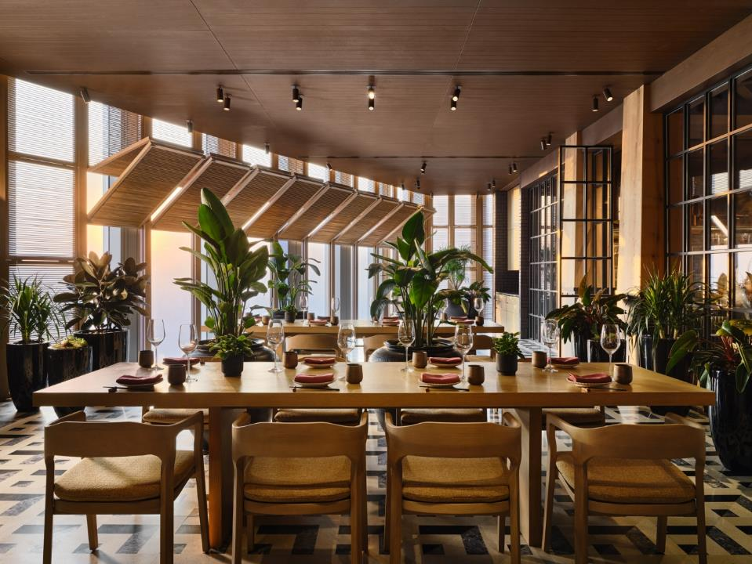
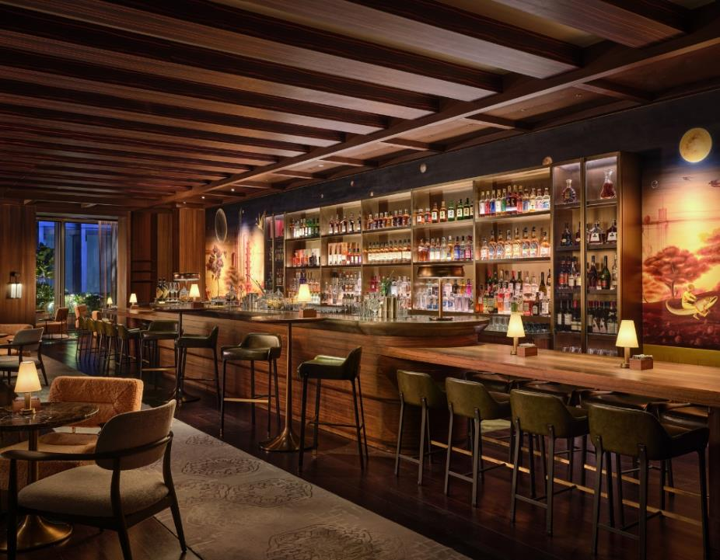
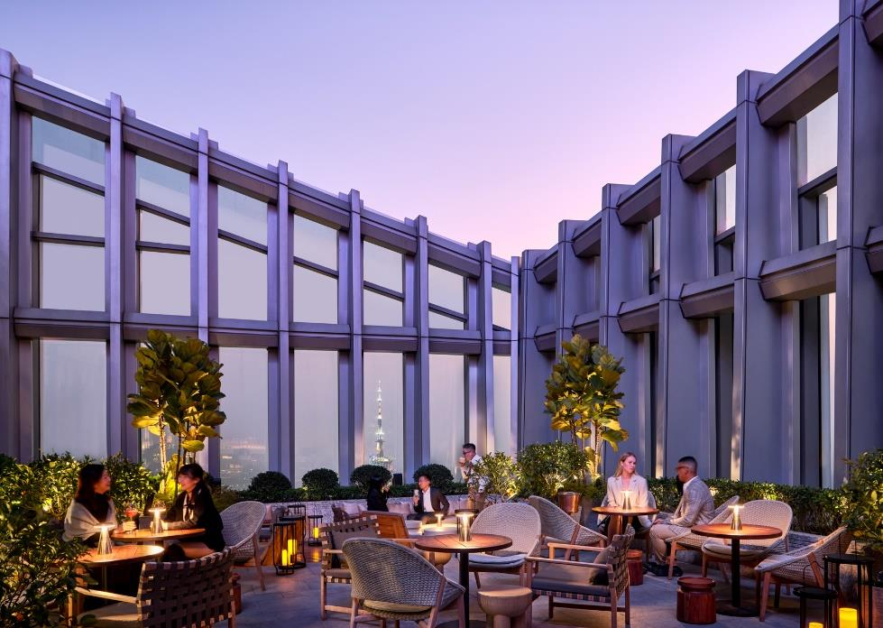
A SENSE OF TASTE
BLACK IRON
Level 107
Seating Capacity 204
TOO HIGH
Level 107
Seating Capacity 138
Exquisite Japanese cuisine prepared at six intimate show kitchens, includes everything from sushi to sashimi, teppanyaki, sukiyaki, shabu-shabu and an extensive seafood menu.
A distinctive cocktail bar area
Highest bar in Guangzhou.
Innovative cocktails and serve a carefully curated list of rare wines, whiskies and sake.

Slide 25
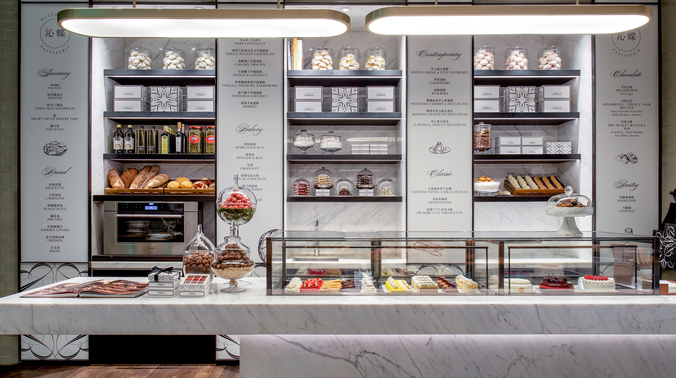
Butterfly Patisserie on L1

Slide 26
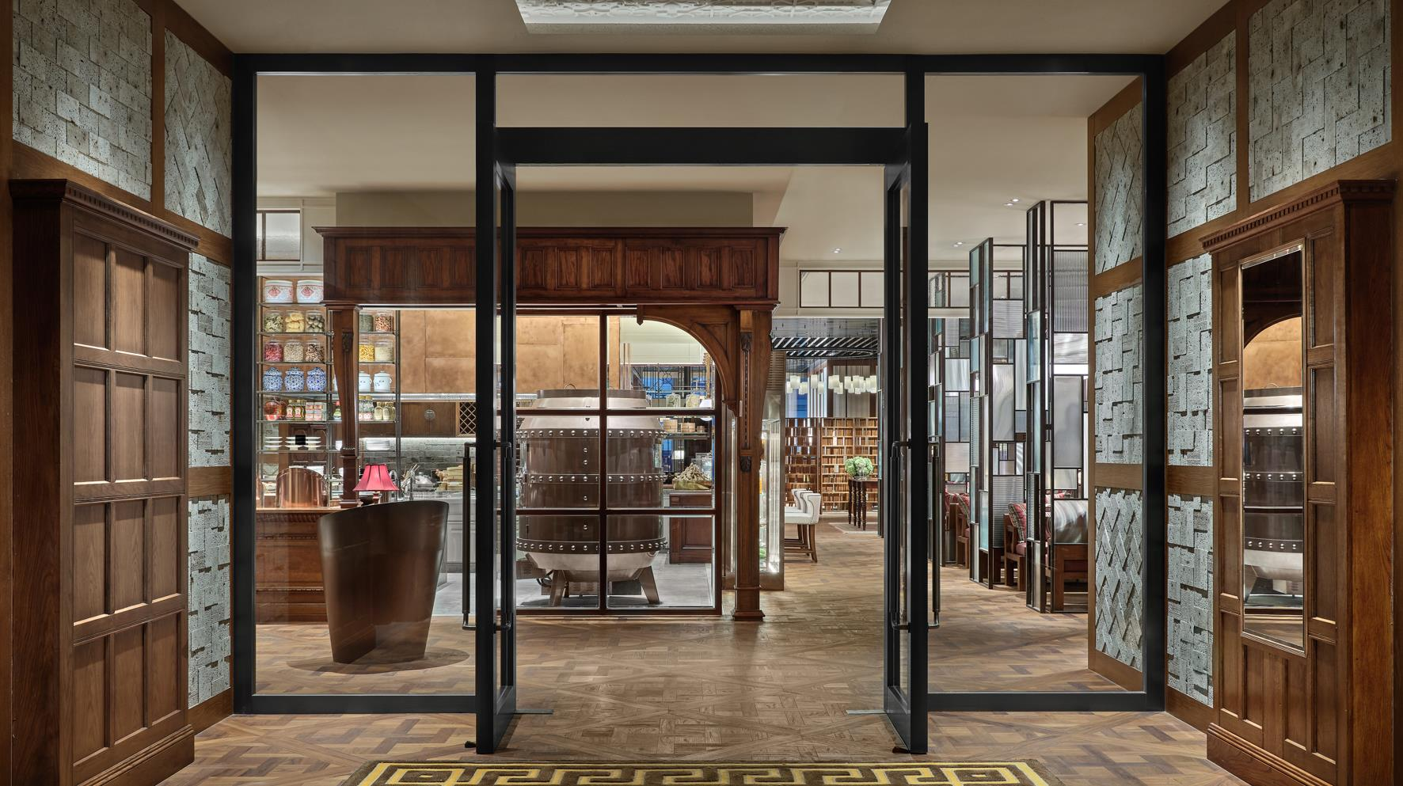
Lingnan House on L5

Slide 27
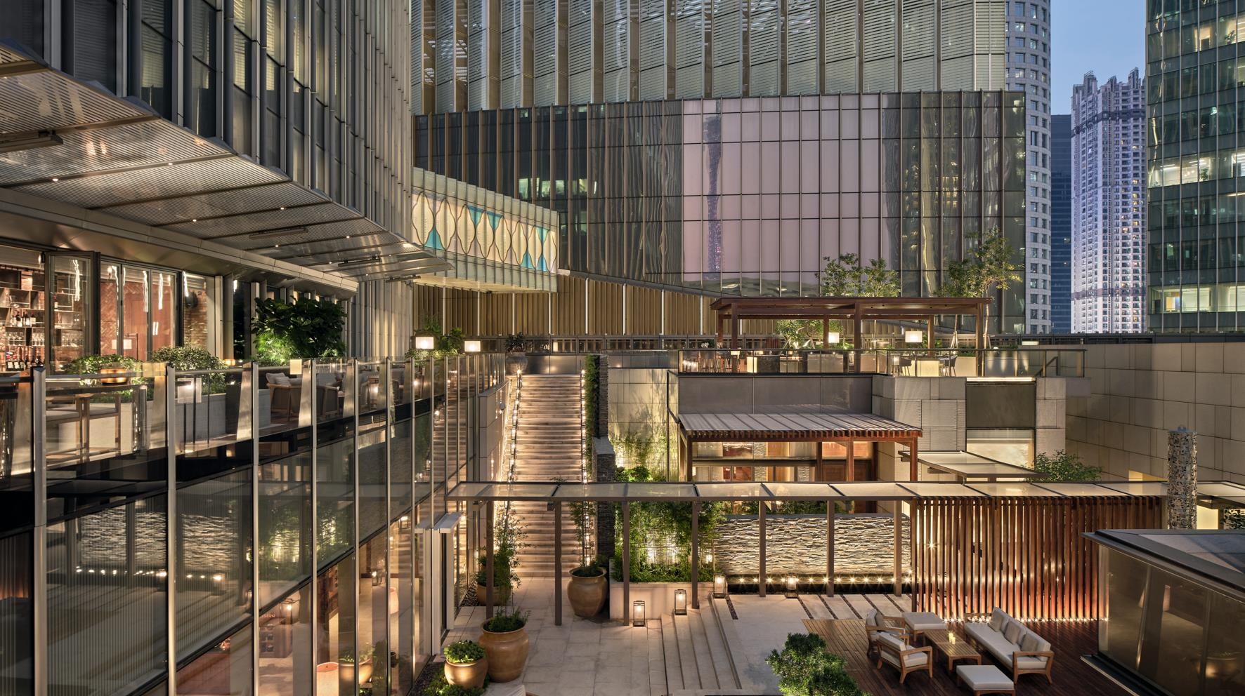
Brick Lane on L6

Slide 28
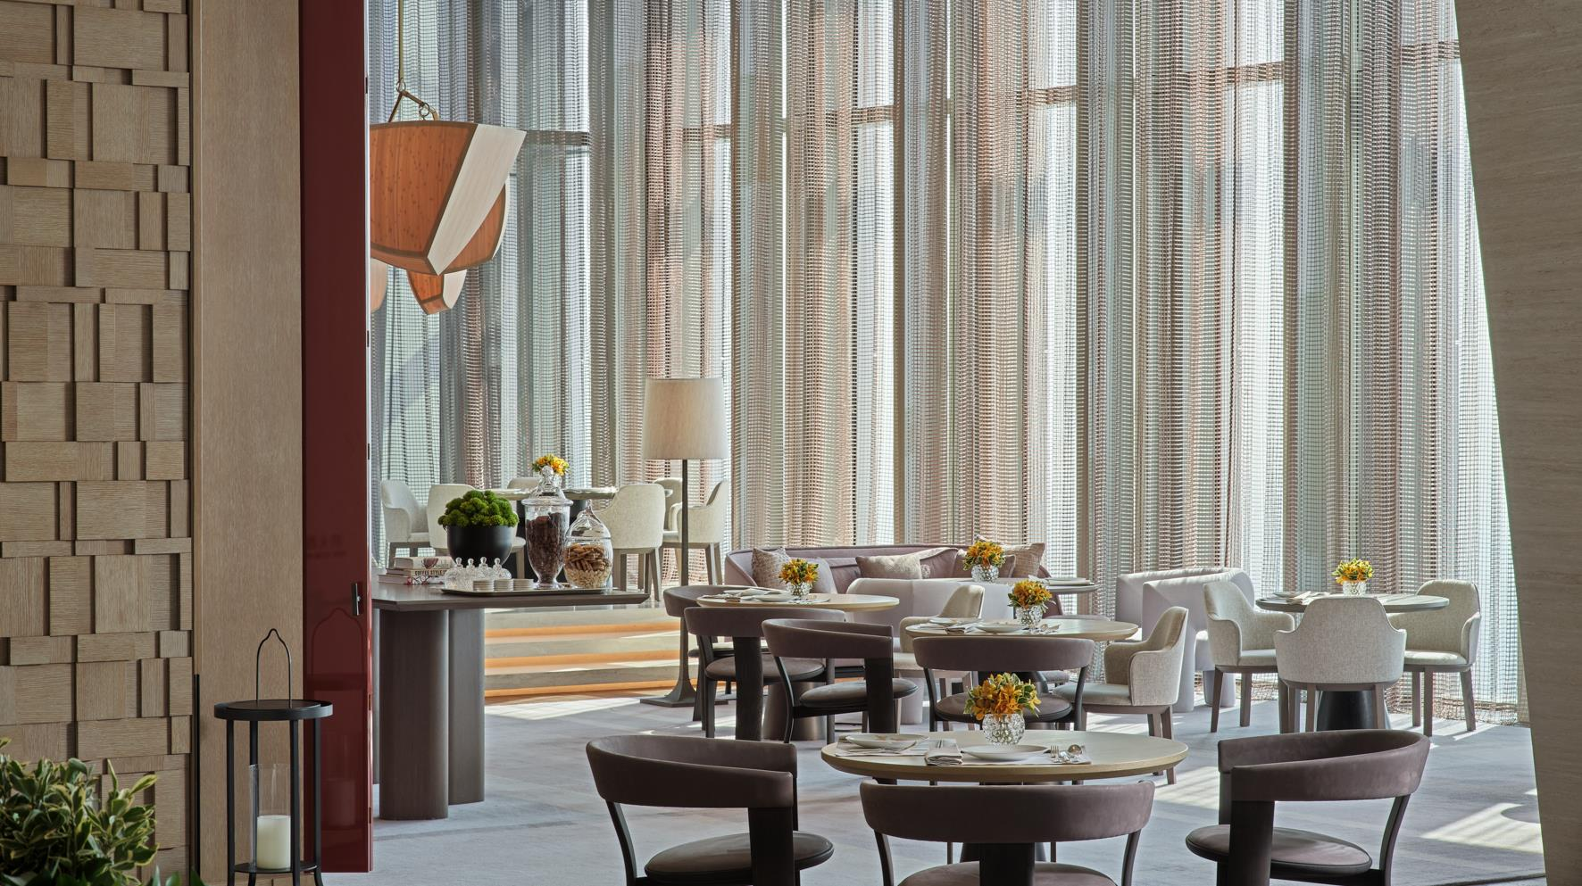
The Butterfly Room on L95

Slide 29
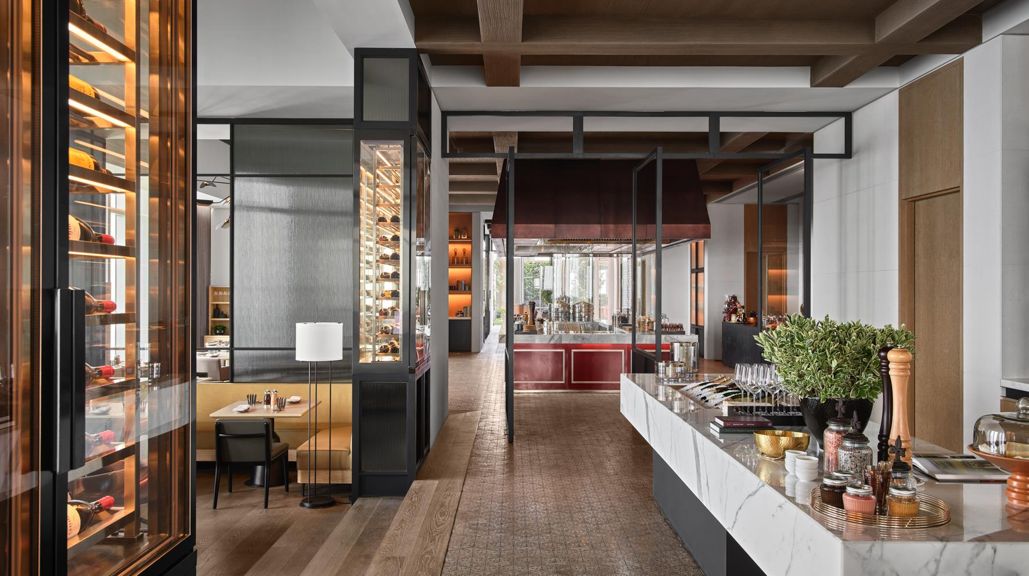
Patina European Brasserie & Terrace on L95

Slide 30
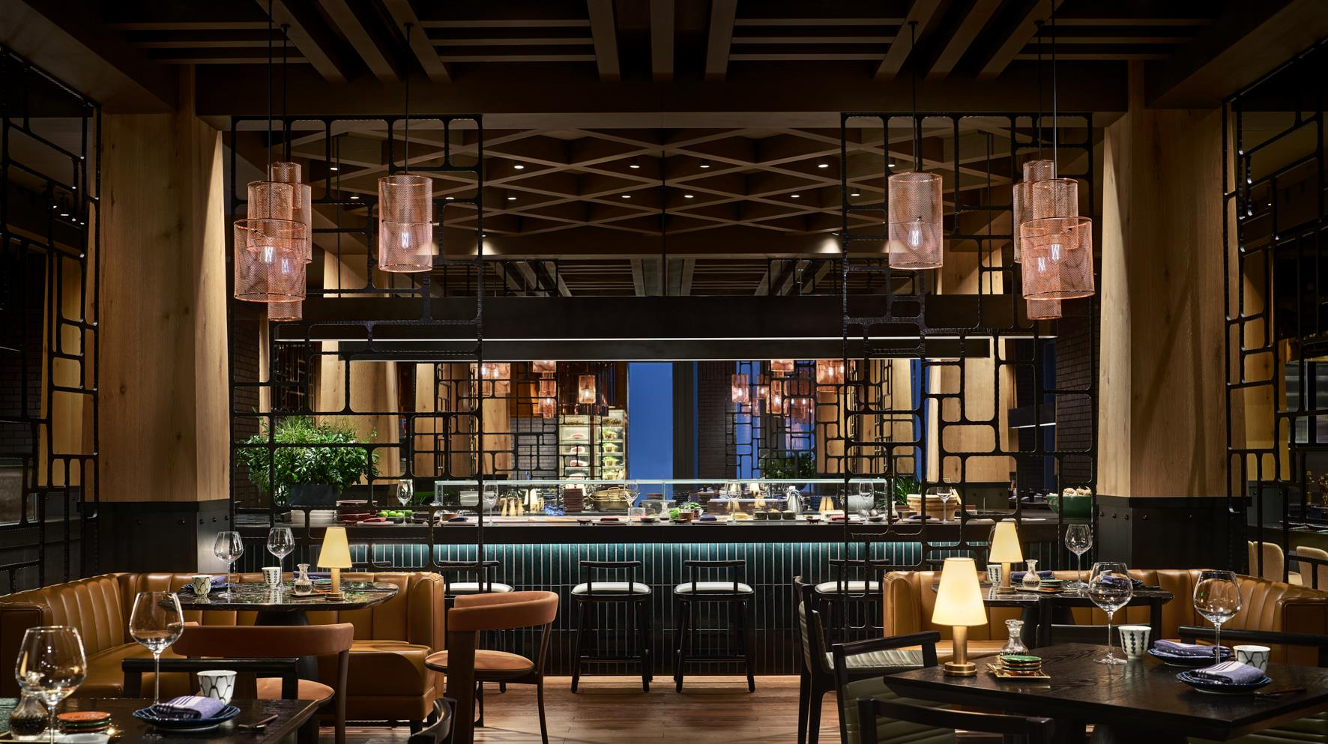
Black Iron on L107

Slide 31
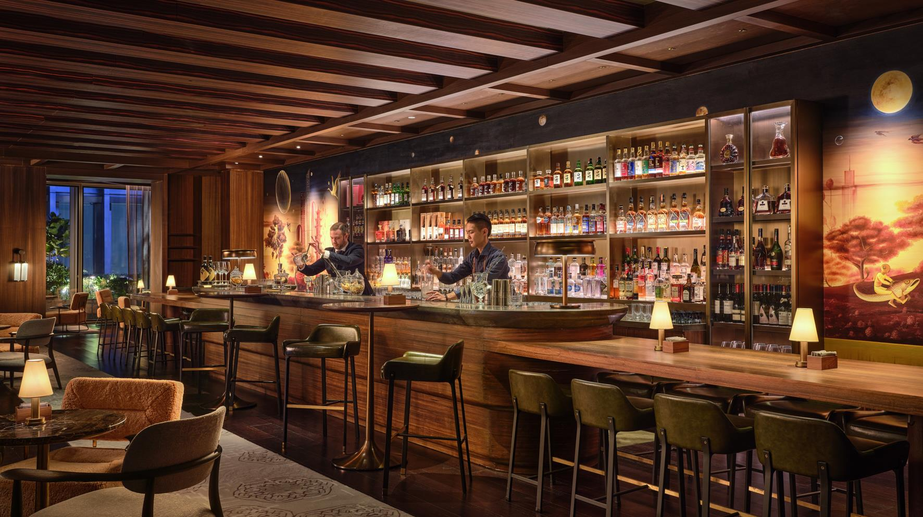
Too High on L107

Slide 32
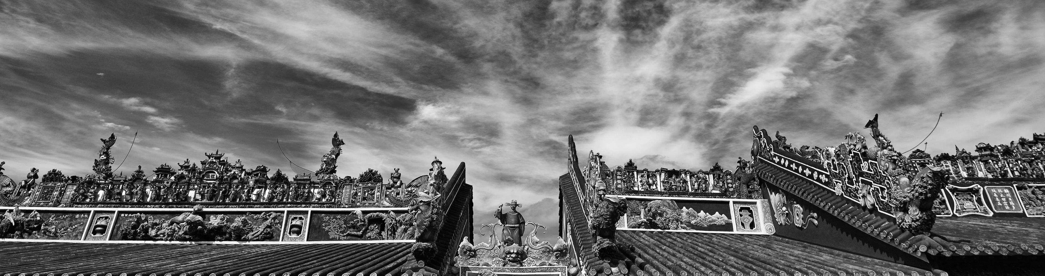
EVENT SPACES

Slide 33
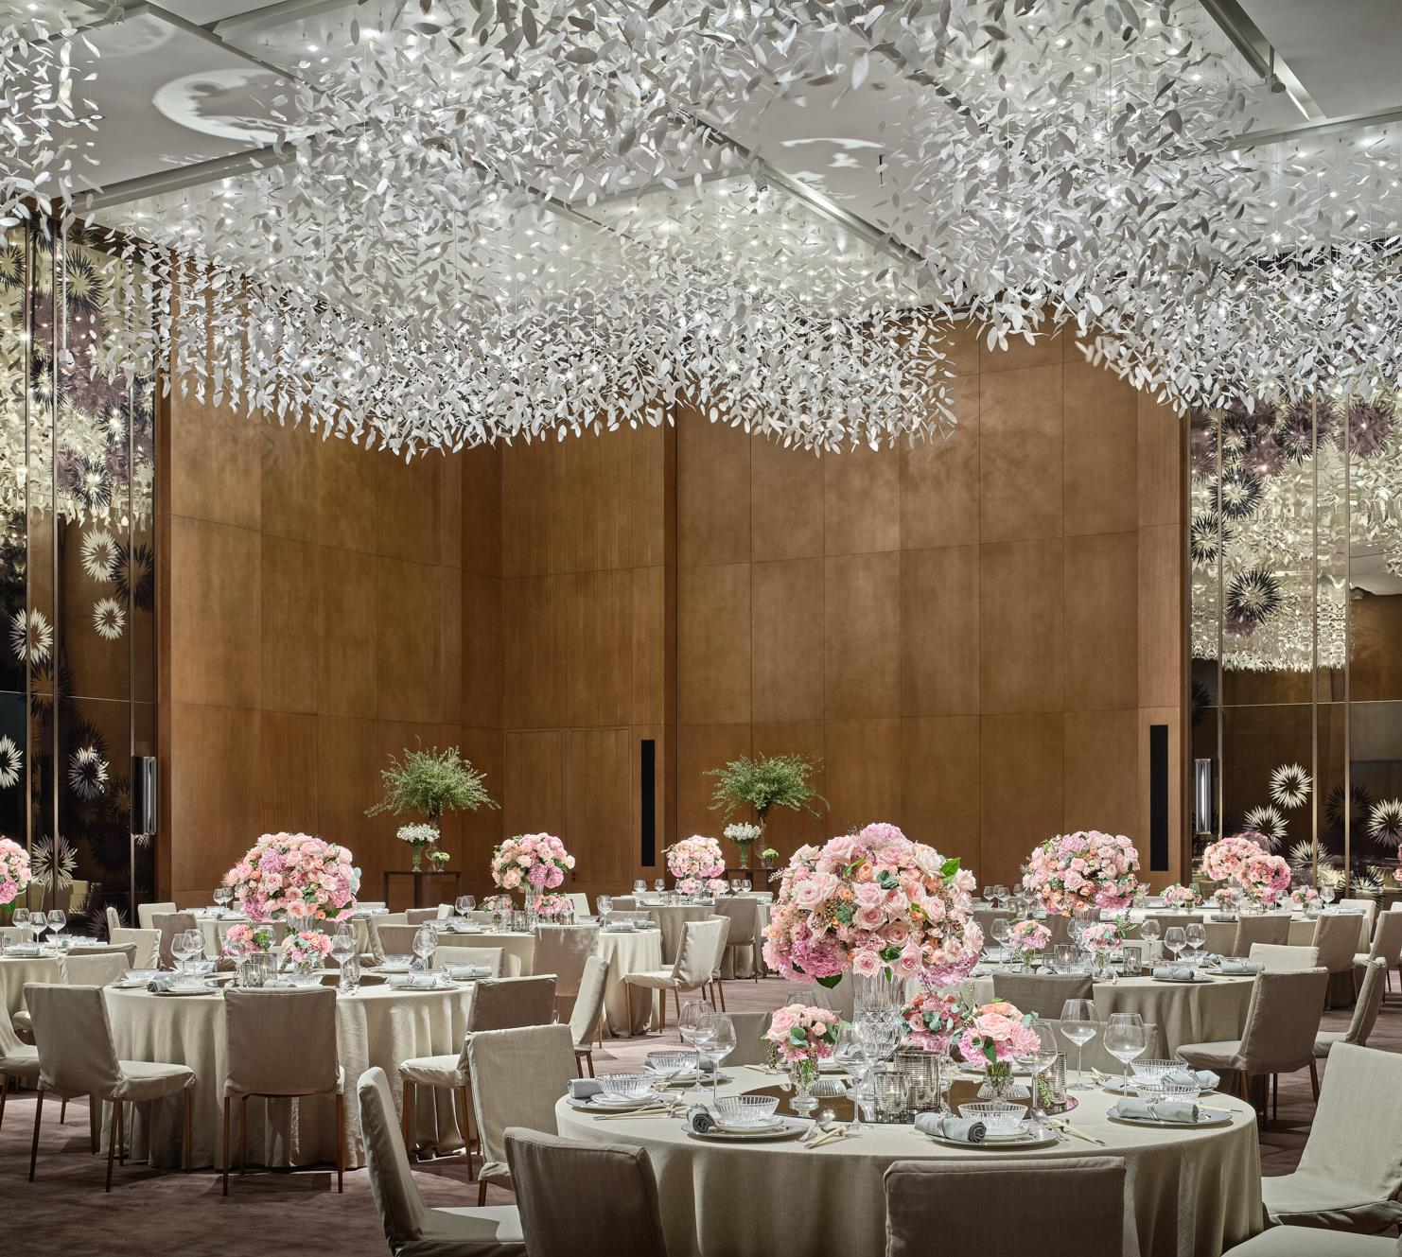
A SENSE OF GATHERING
Stretching across the top floors of the CTF Finance Centre, Rosewood Guangzhou’s spacious, light-filled venues encompass a ballroom, three galleries, two VIP rooms, a bridal room, multiple meeting rooms and the ultra-exclusive Mansion, China’s highest event space.
GRAND BALLROOM – L3 / 958m²
Unforgettable occasions for up to 700 guests unfold in the hotel’s Grand Ballroom. The venue includes a pre-function foyer, bridal room and versatile reception area. For more intimate affairs, the 958-square-meter hall can be divided into smaller function spaces.
PAVILION – L4 / 359m²
Evoking the air of a grand residence, this refined multi-purpose venue provides a highly exclusive, private space for meetings, events and social occasions.
MANSION – L108 / 300m²
Sleek and contemporary, the 108th-floor Mansion provides a soothing environment with unrivalled views of the Pearl River and Tianhe District. Interactive dining experiences, a spacious terrace and world-class services distinguish China’s highest event space.

Slide 34
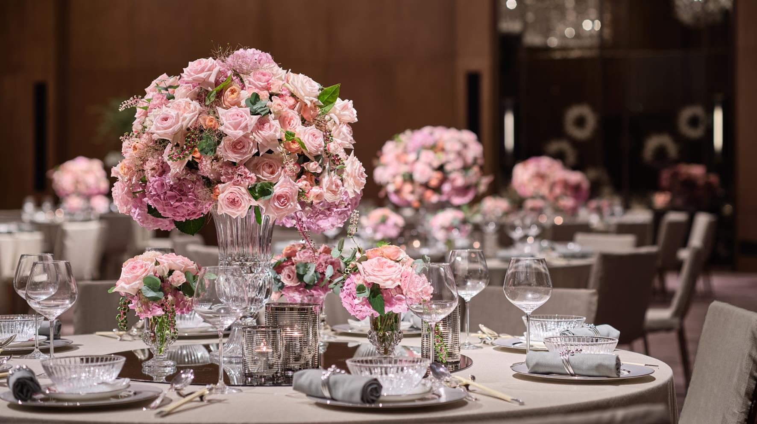
Grand Ballroom on L3

Slide 35
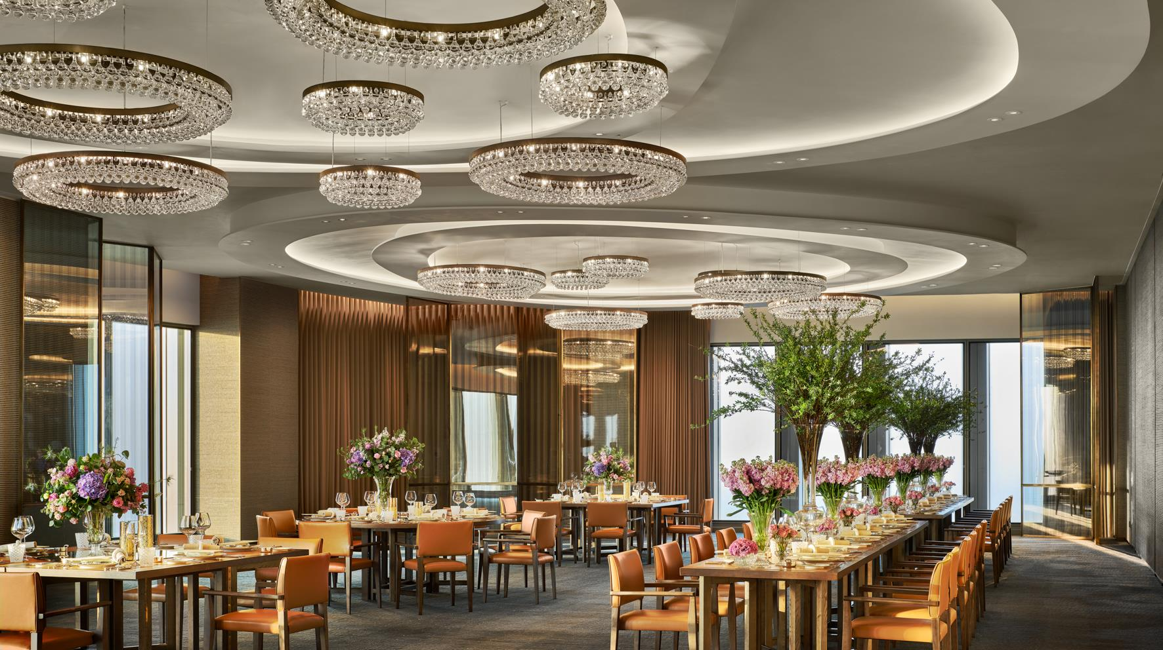
Mansion on L108

Slide 36
CAPACITY CHART & FLOOR PLANS
3rd Floor | SQM | Size (M) | Height (M) | Reception | Banquet | Theatre | Classroom | U Shape
Grand Ballroom | 958 | 32 x 29.9 | 7.9 | 700 | 560 | 700 | 364 | -
Ballroom 1 | 480 | 32 x 15 | 7.9 | 350 | 280 | 350 | 168 | -
Ballroom 2 | 260 | 17.4 x 14.9 | 7.9 | 190 | 140 | 190 | 84 | -
Ballroom 3 | 218 | 14.9 x 14.6 | 7.9 | 160 | 100 | 160 | 72 | -
Ballroom Foyer 1 | 230 | 38 x 6 | 5.4 | 240 | - | - | - | -
Ballroom Foyer 2 | 270 | 29 x 9.3 | 5.5 | 250 | - | - | - | -
Gallery 301 | 100 | 12 x 8.3 | 4.5 | 90 | 50 | 108 | 42 | 40
Gallery 303 | 135 | 9.6 x 14 | 4.5 | 110 | 60 | 132 | 64 | 50
Gallery 305 | 110 | 9.2 x 12 | 4.5 | 70 | 40 | 62 | 30 | 30
4th Floor | SQM | Size (M) | Height (M) | Reception | Banquet | Theatre | Classroom | U Shape
Salon 401 | 100 | 12.5 x 8 | 4.5 | 100 | 50 | 110 | 42 | -
Salon 402 | 89 | 12.2 x 7.3 | 4.5 | 80 | 50 | 88 | 36 | -
Salon 403 | 90 | 10 x 9 | 4.5 | 90 | 40 | 94 | 36 | -
Salon 404 | 80 | 9.1 x 8.8 | 4.5 | 80 | 40 | 84 | 30 | -
Bar | 35 | 4.8 x 7.3 | 4.5 | 11 | - | - | - | -
Kitchen | 105 | 9.3 x 11.3 | 4.5 | - | 24 | - | - | -
Belvedere Suite | 100 | 9 x 11 | 4.5 | 12 | - | - | - | -
Living Room | 100 | 8 x 12.5 | 4.5 | 34 | - | - | - | -
Boardroom | 40 | 5.2 x 7.7 | 4.5 | - | 12 | - | - | -
108th Floor | SQM | Size (M) | Height (M) | Reception | Banquet | Theatre | Classroom | U Shape
Mansion | 300 | 13 x 23 | 4.9 | 250 | 150 | 74 | - | -
Mansion Foyer | 119 | - | 4.9 | - | - | - | - | -
Bar | 65 | 4.6 x 14 | 4.9 | - | - | - | - | -

Slide 37
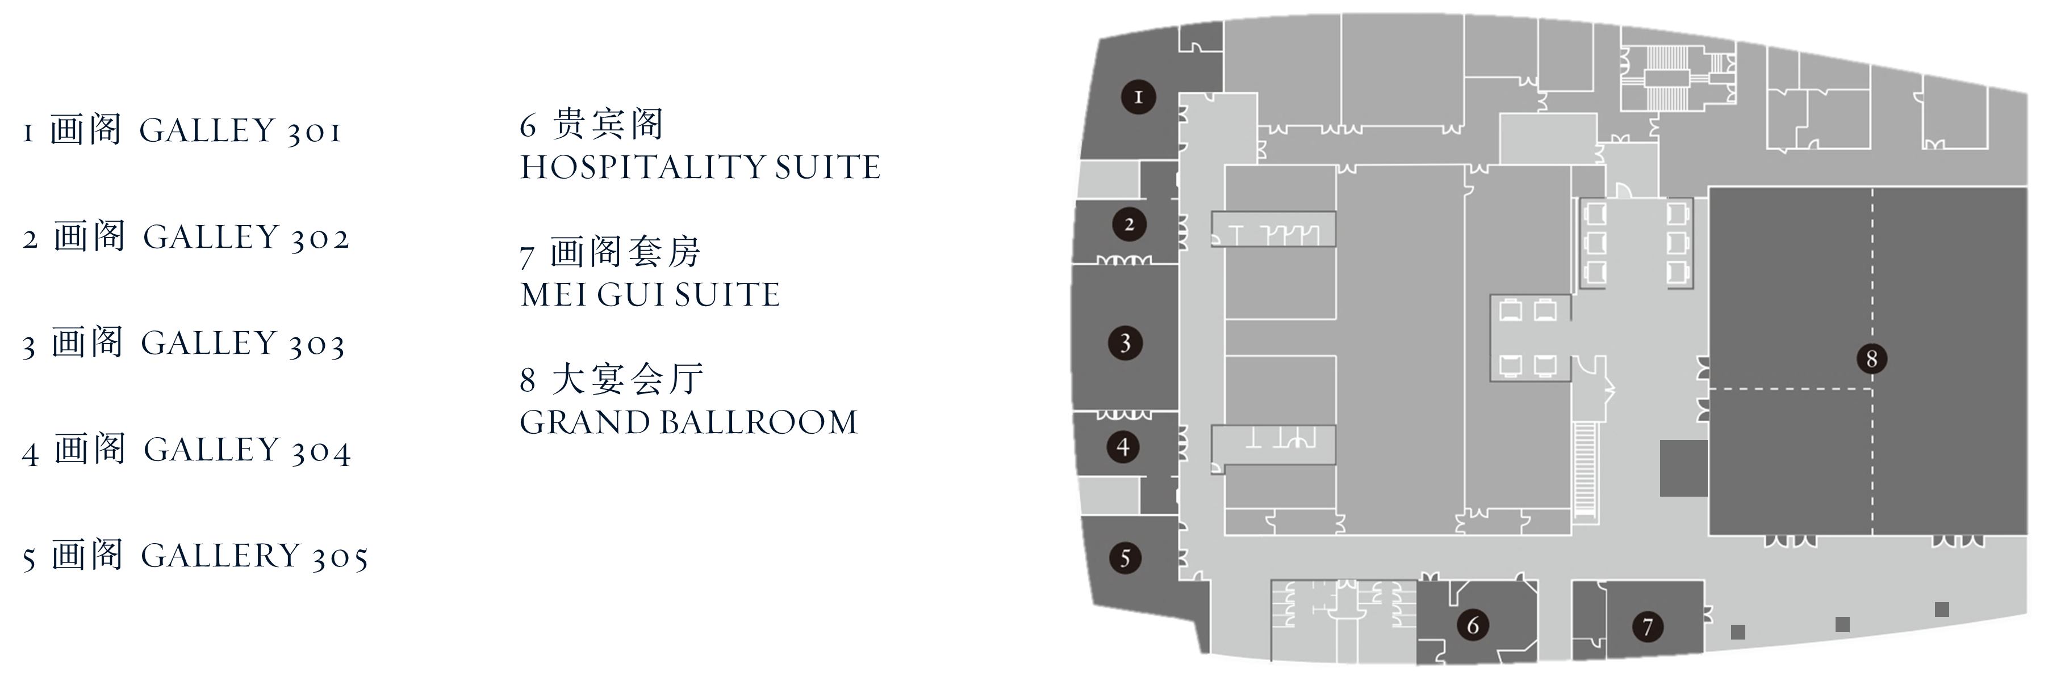
LEVEL 3 – GRAND BALLROOM & GALLERY

Slide 38
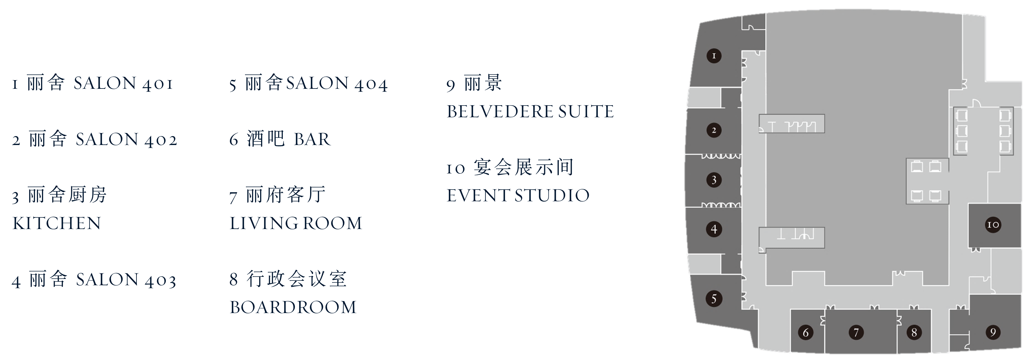
LEVEL 4 - PAVILION

Slide 39
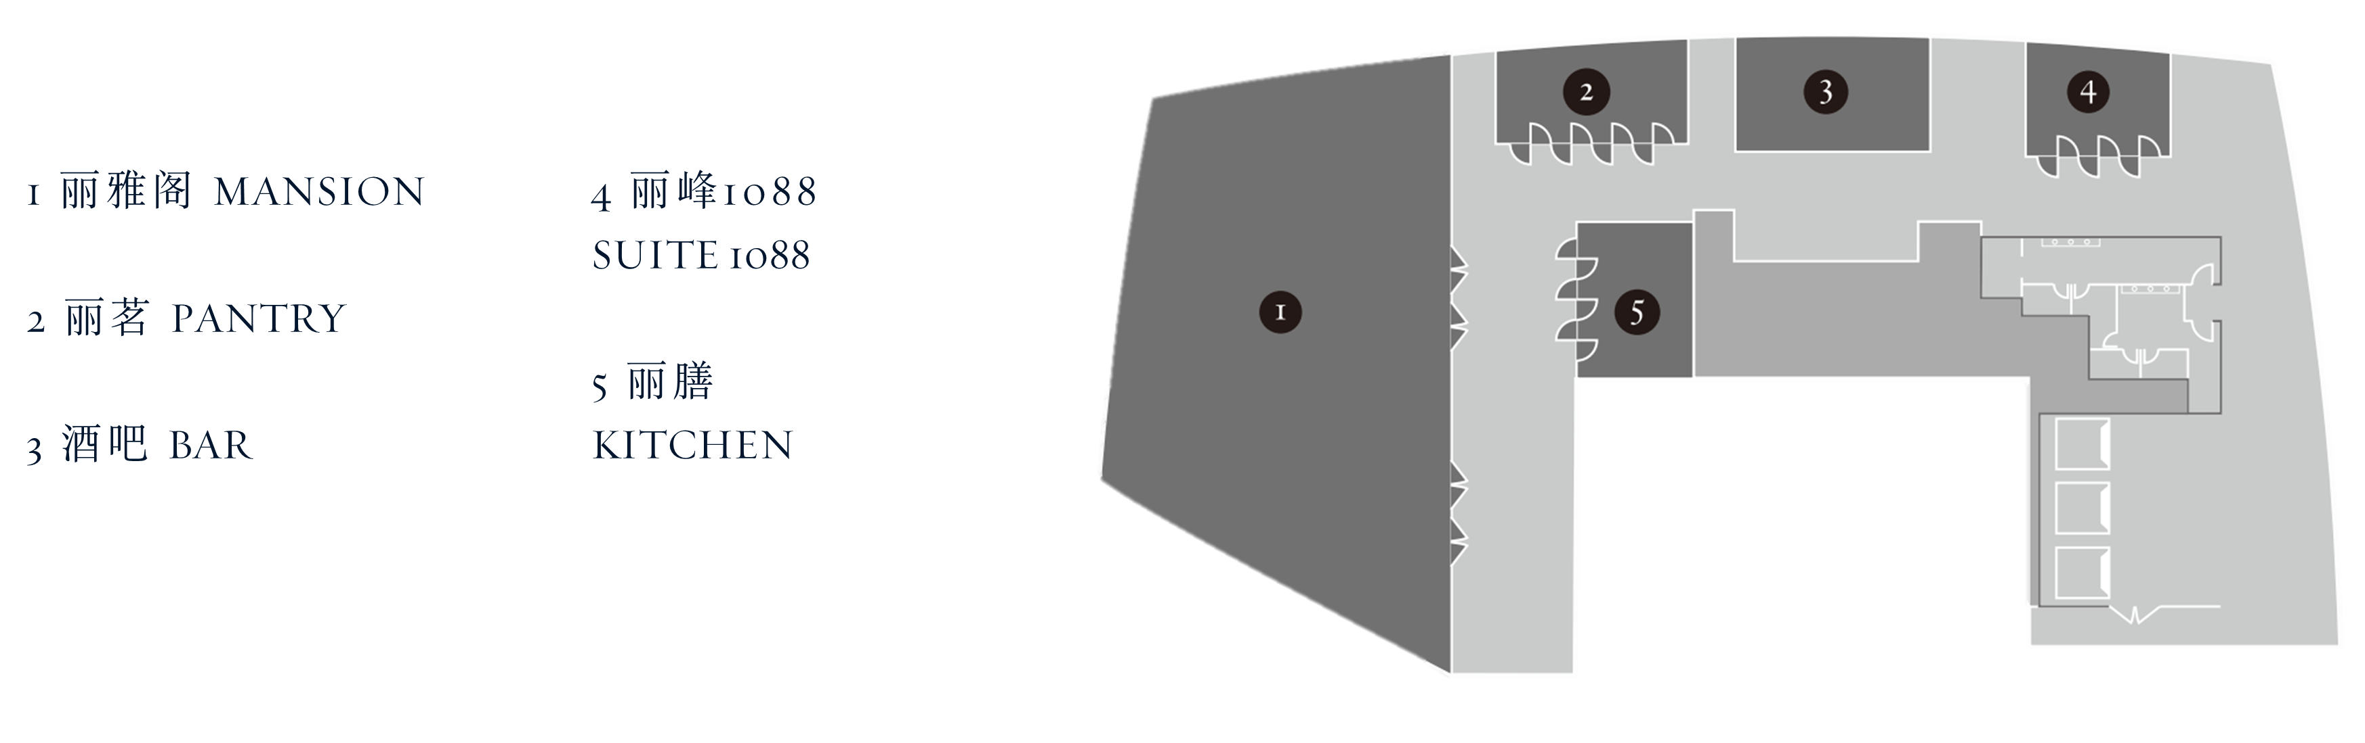
LEVEL 108 - MANSION

Slide 40
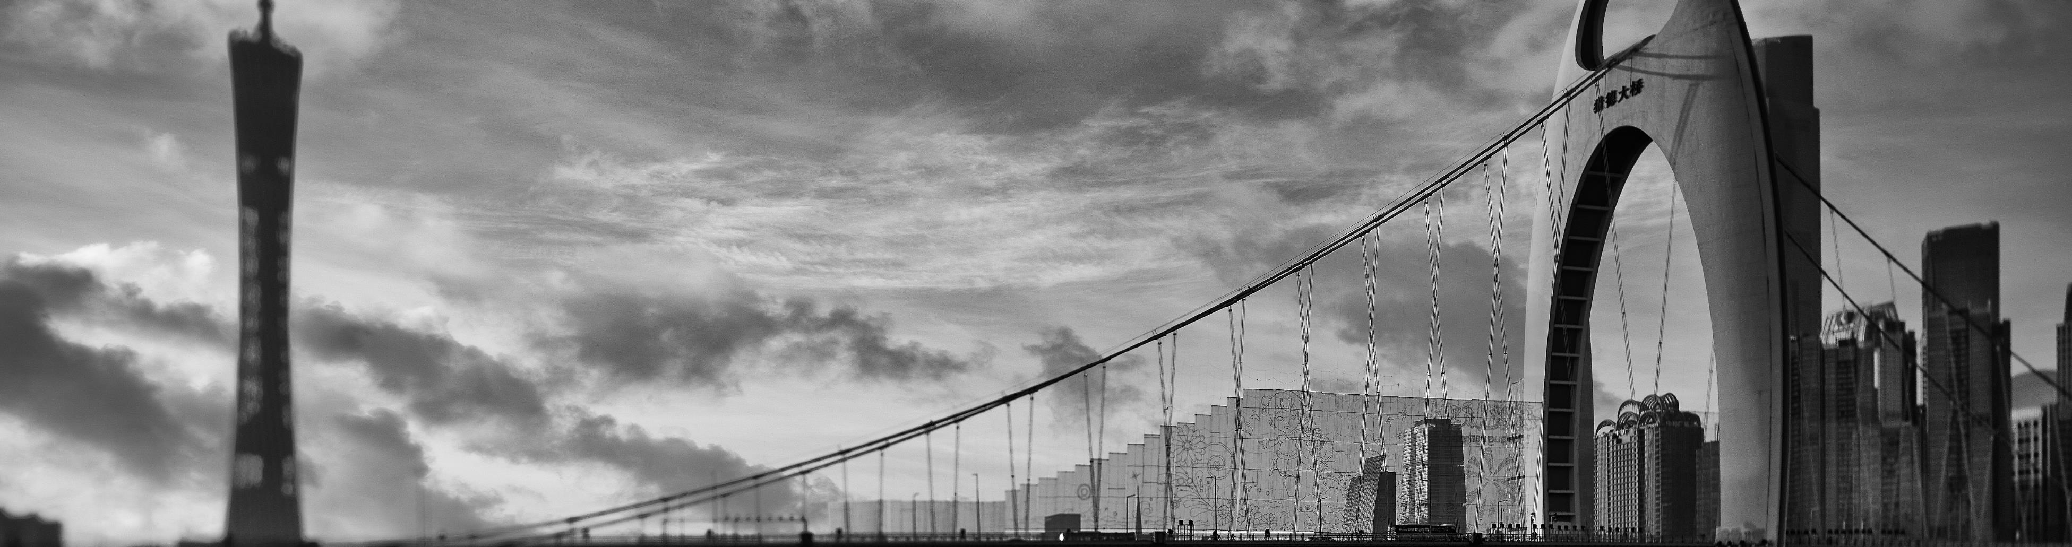
WELLNESS FACILITY

Slide 41
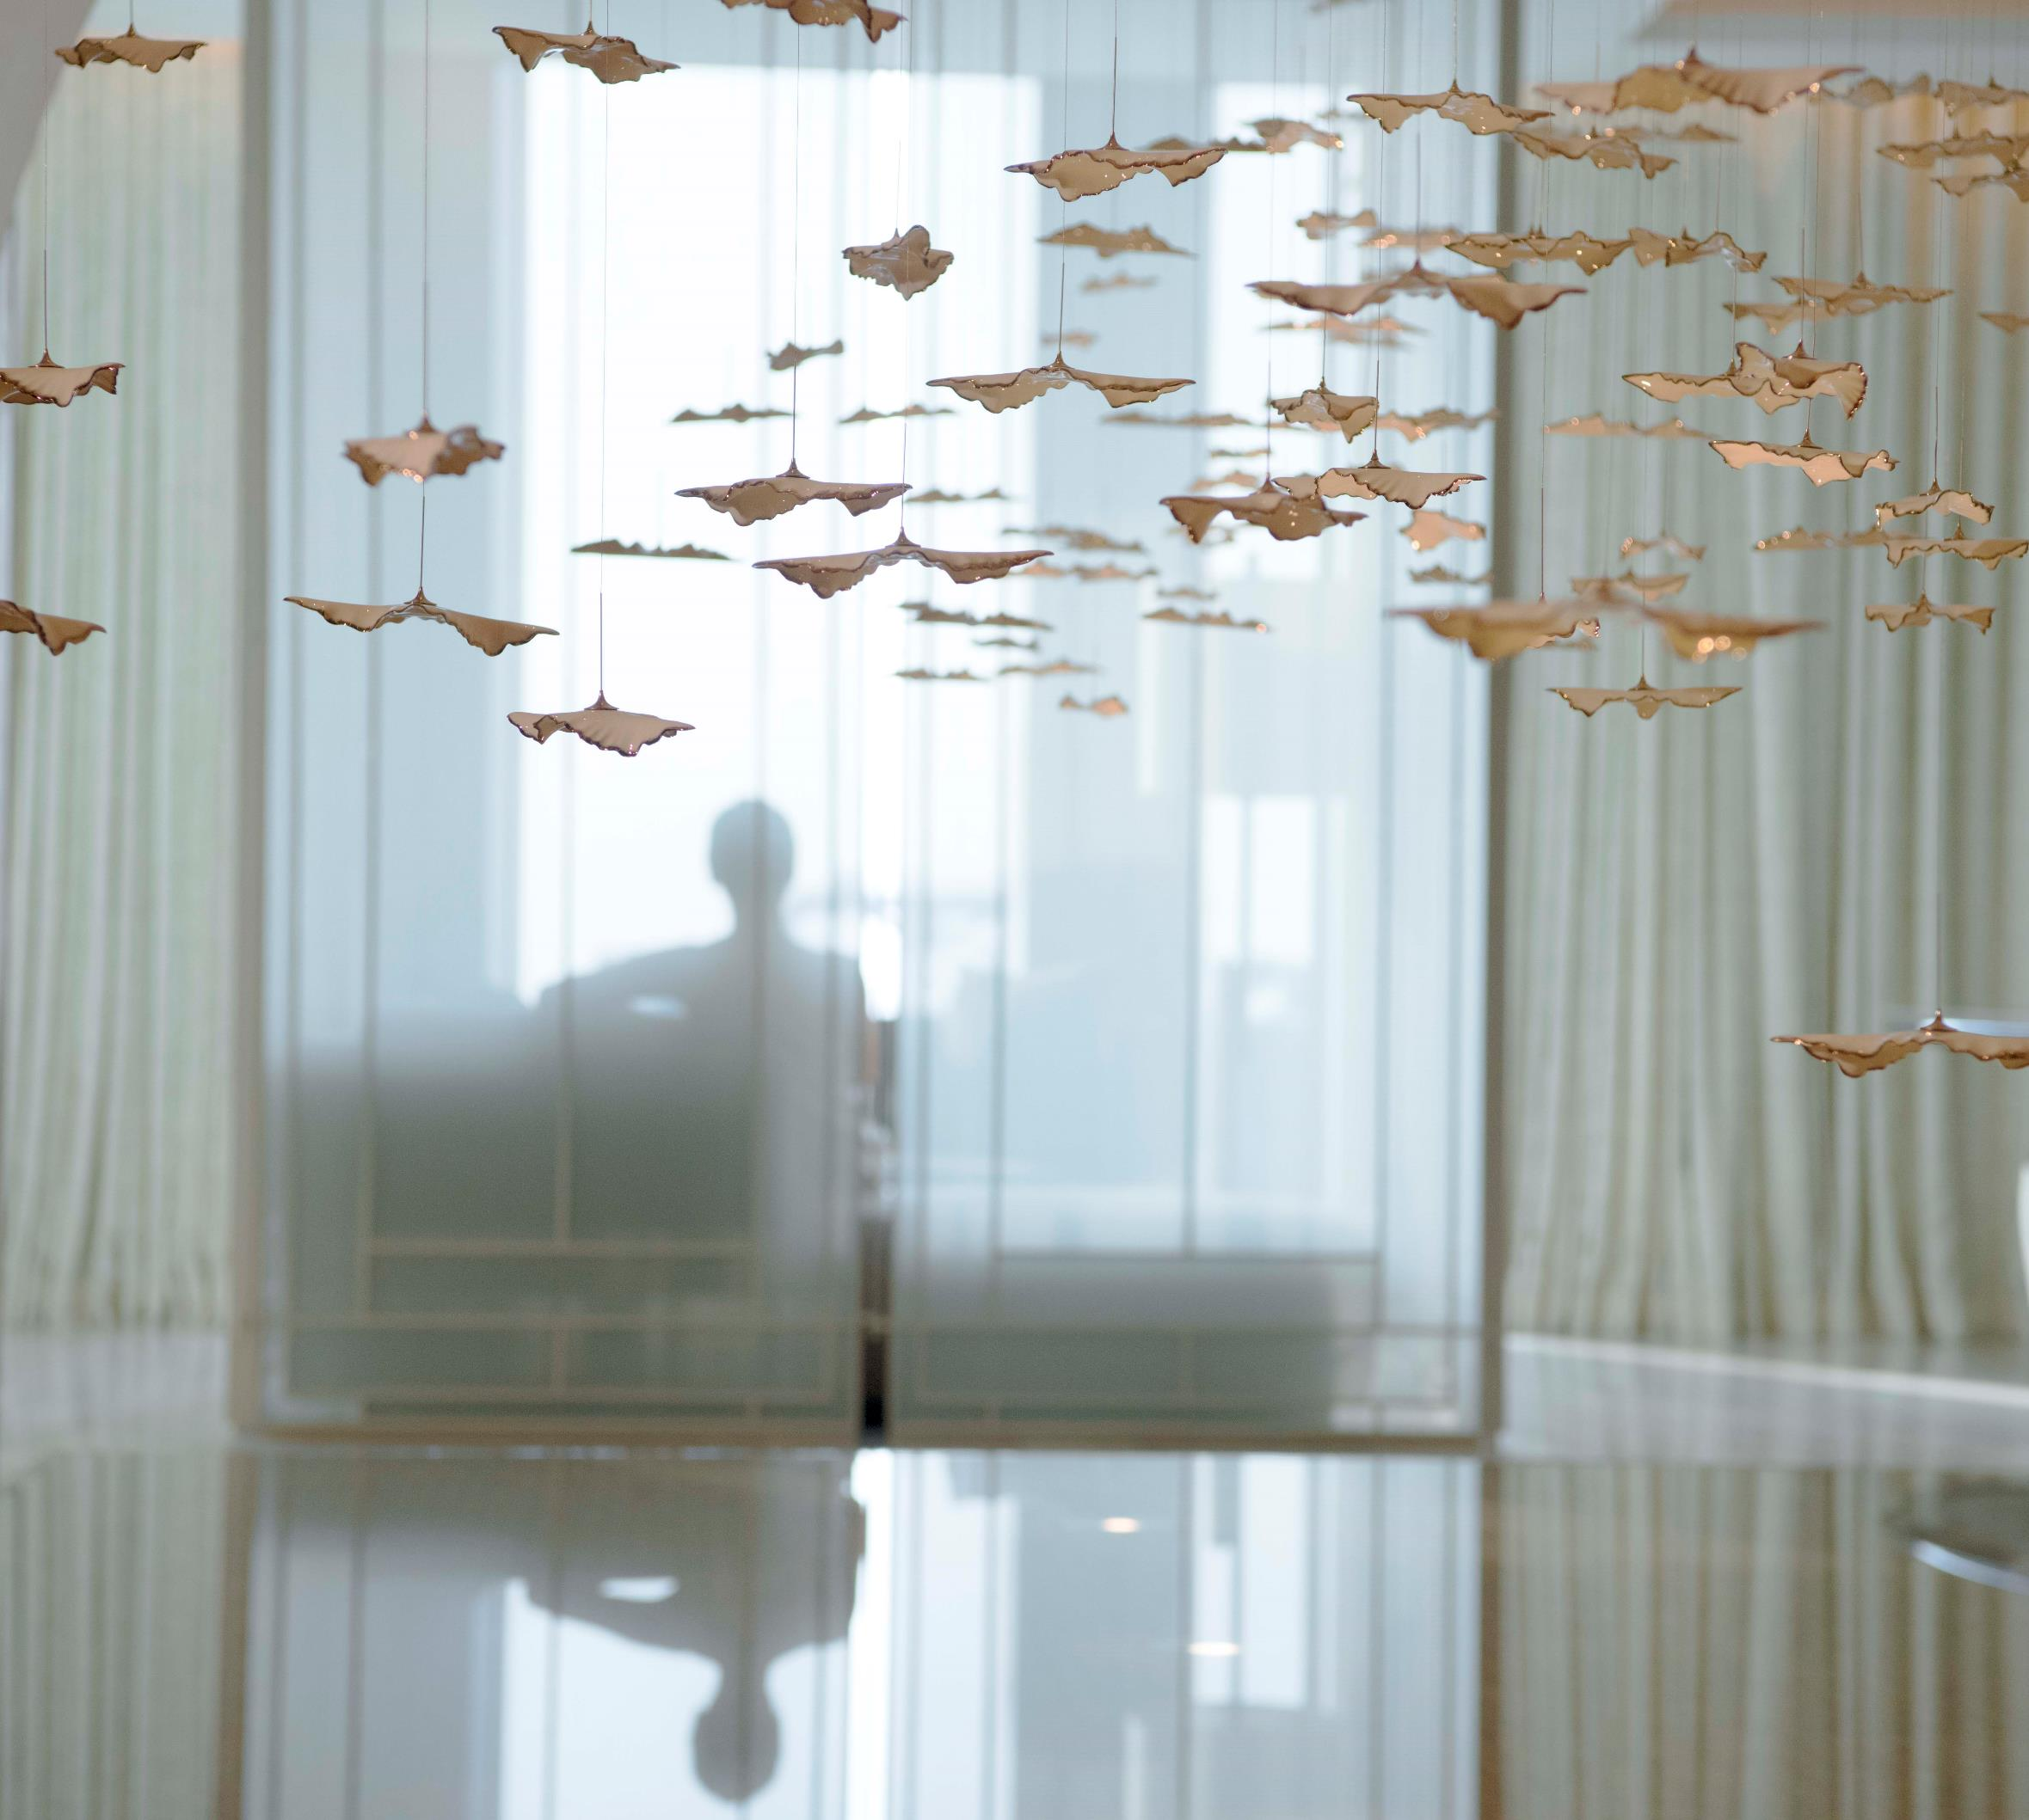
A SENSE OF WELLNESS
ASAYA ACTIVE
Spanning two light-filled floors, the holistic wellness concept soothes the body and mind with reflective, carefully crafted interiors, luxurious treatments, a state-of-the-art fitness studio, yoga classes and a tranquil indoor swimming pool.
- FITNESS STUDIO at L93
- MOVEMENT STUDIO at L93
- POOL at L94

Slide 42
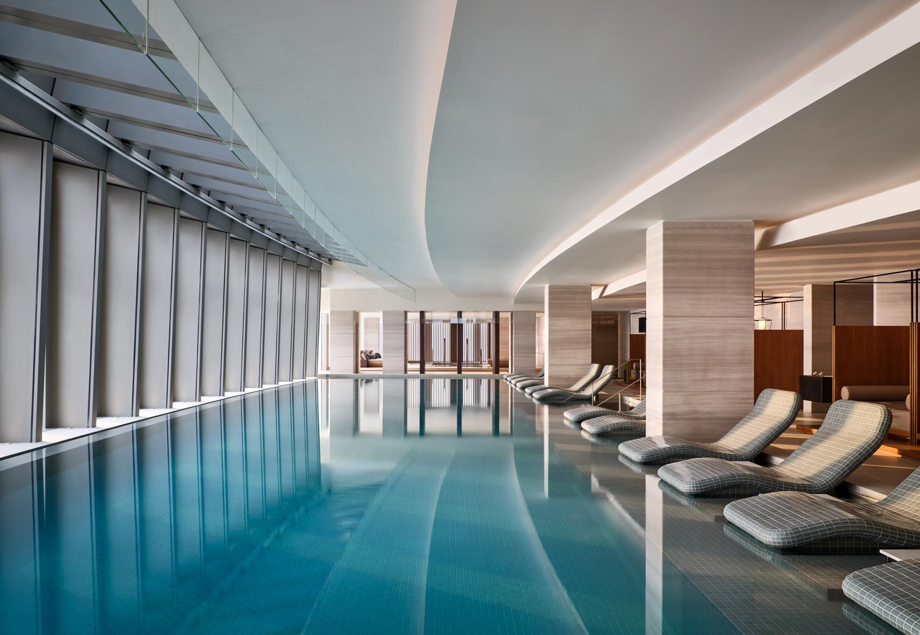
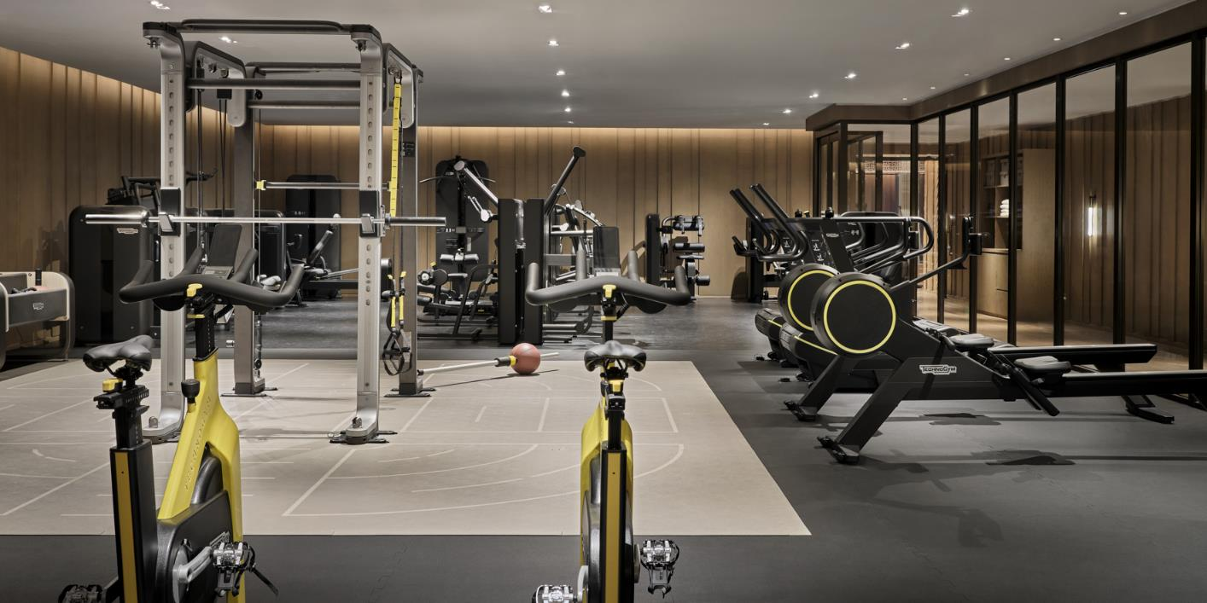
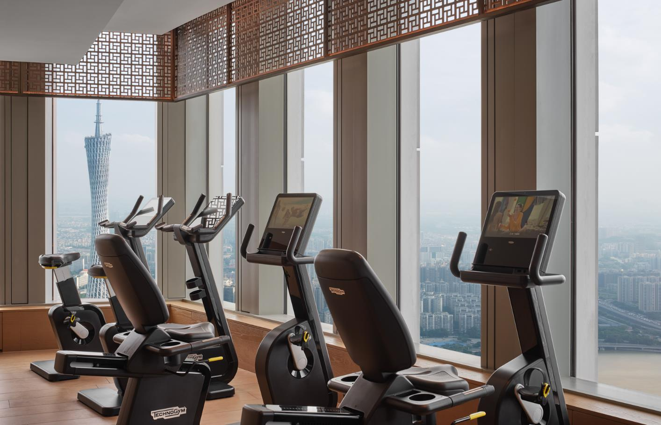
ASAYA ACTIVE
Fitness Studio on L93
Swimming Pool on L94

Slide 43


